Slide 1
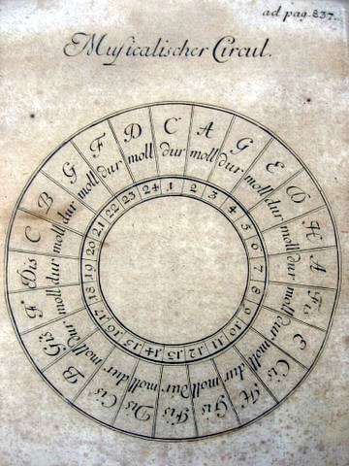
Linear Techniques 2

Slide 2
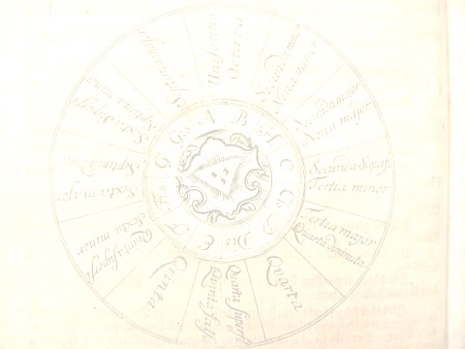
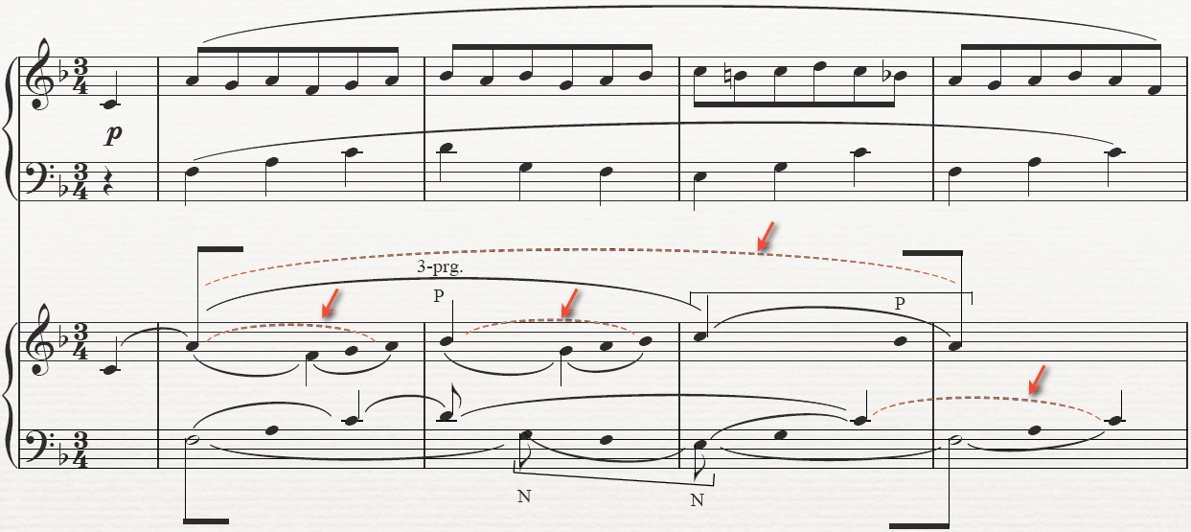
dotted lines connect the same notes

Slide 3
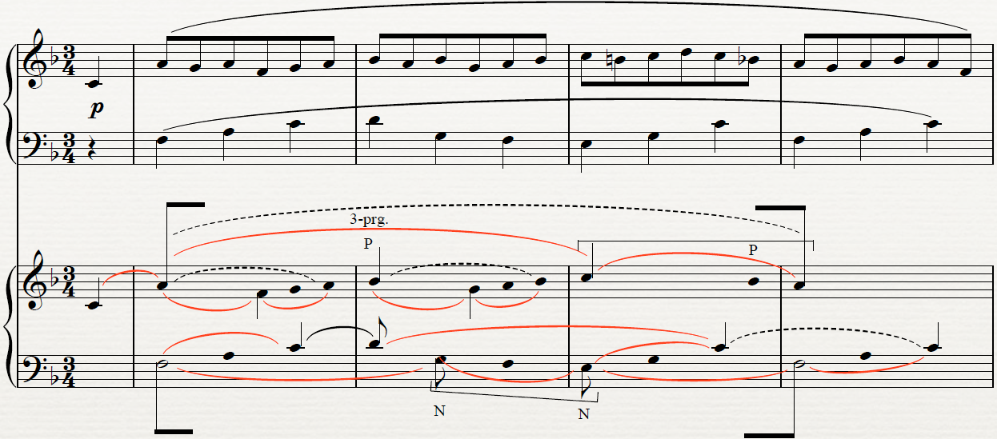
slurs connect CS and Arp

Slide 4
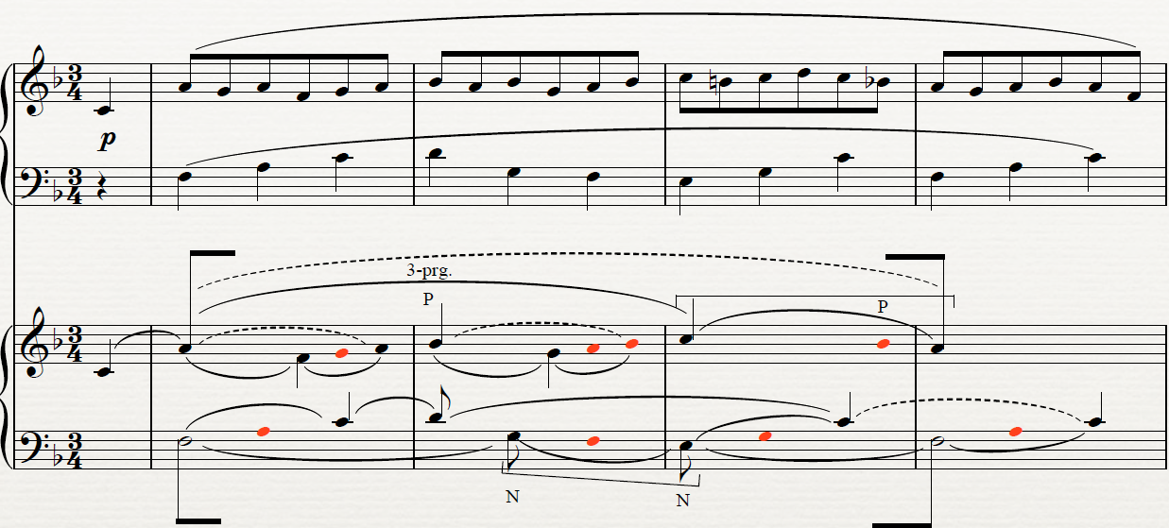
red notes are P and middle of Arp

Slide 5
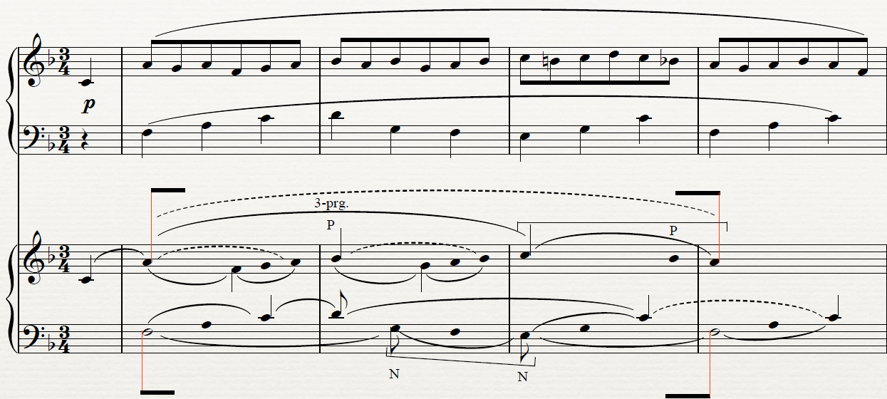
long beams indicate most important structural pitches

Slide 6
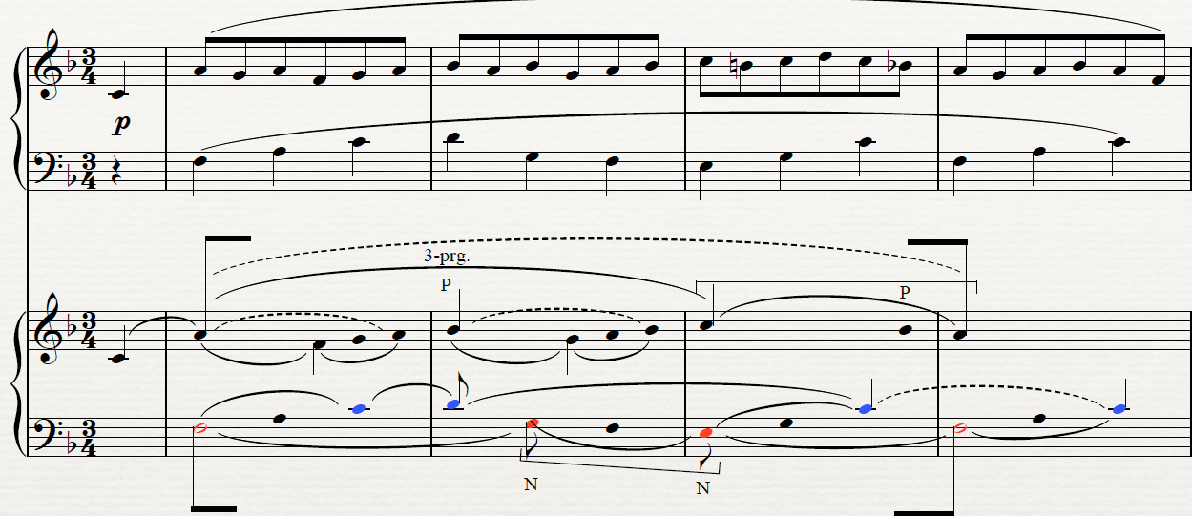
stem direction indicates polyphony; here 4 voices

Slide 7
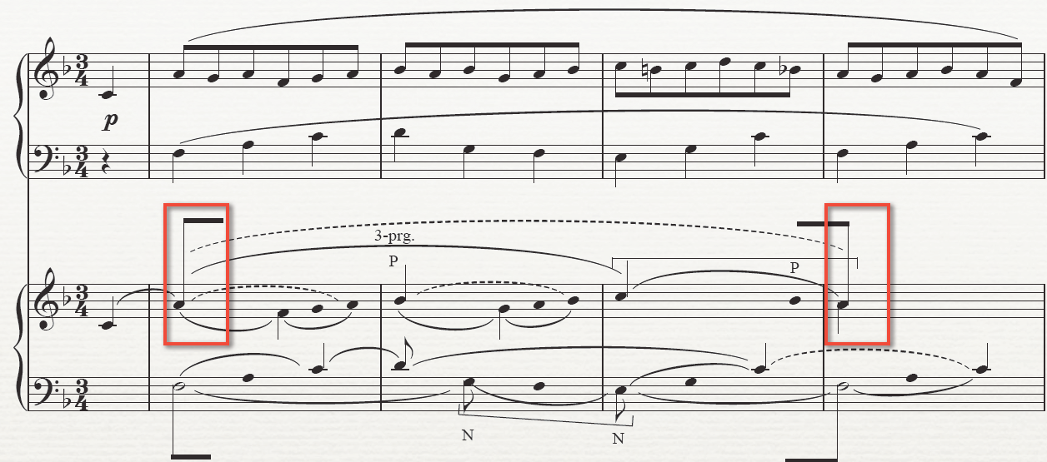
beam connects head tone, shows prolongation

Slide 8
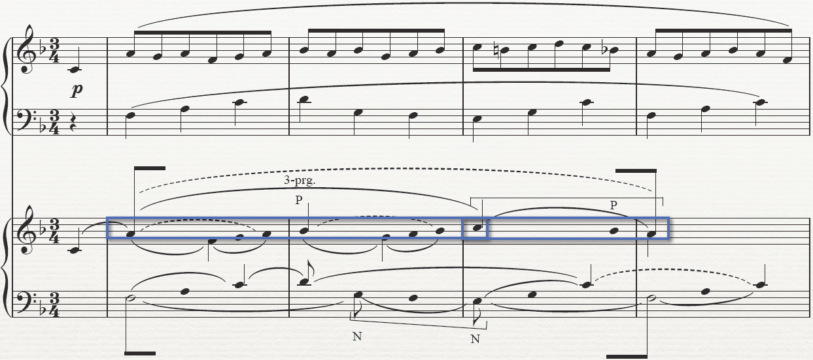
3-prg!

Slide 9
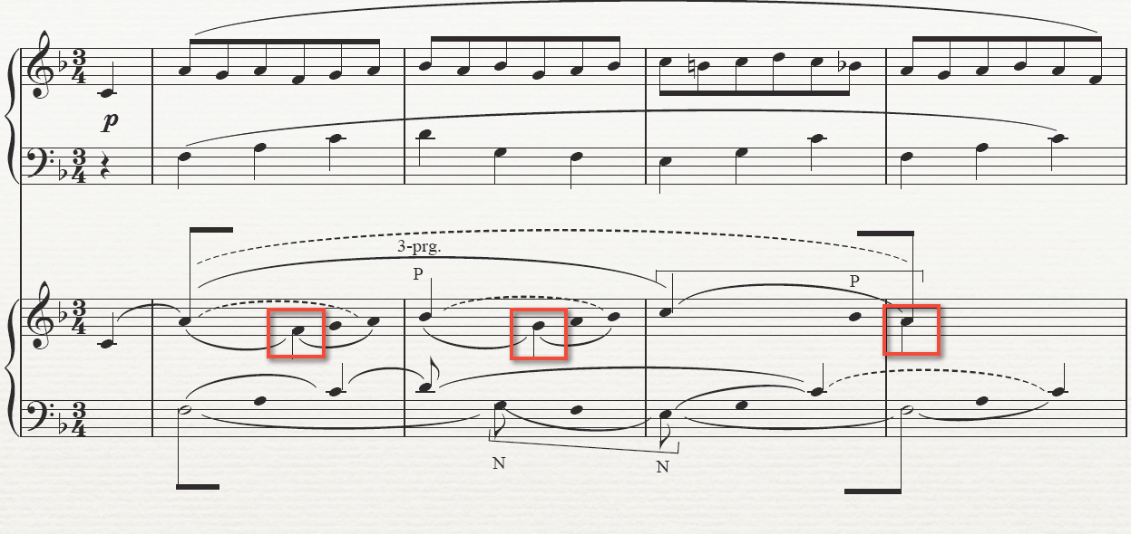
3-prg in alto!

Slide 10
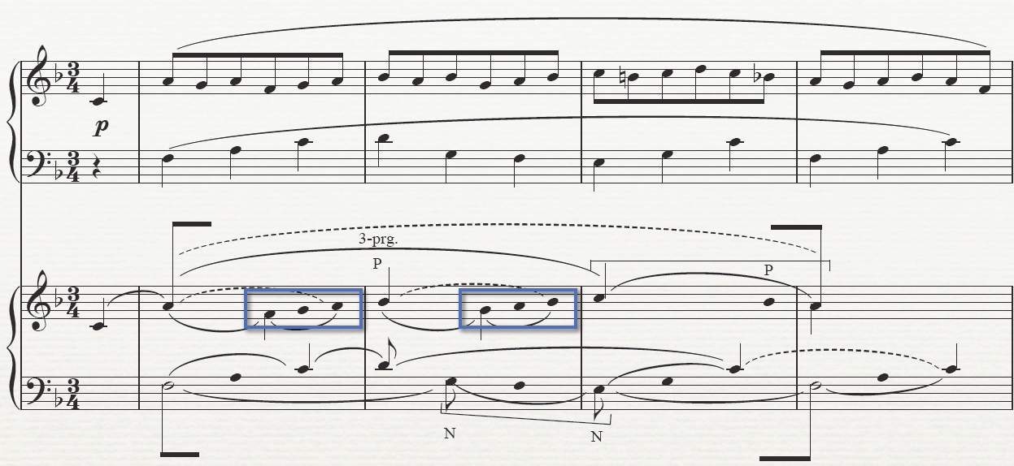
little 3s

Slide 11
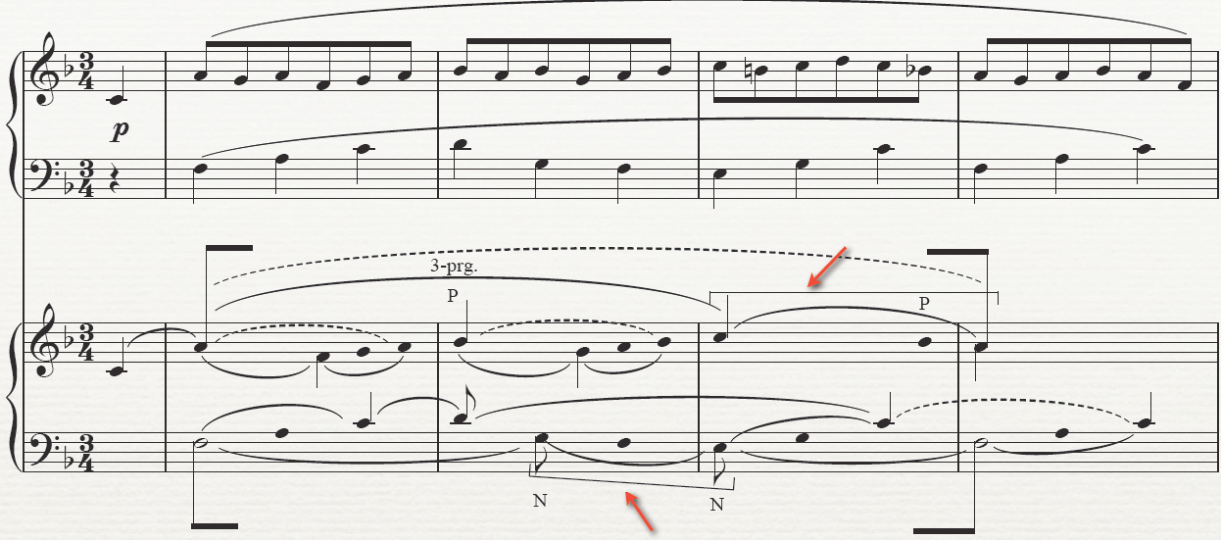
optional: bracket motives

Slide 12
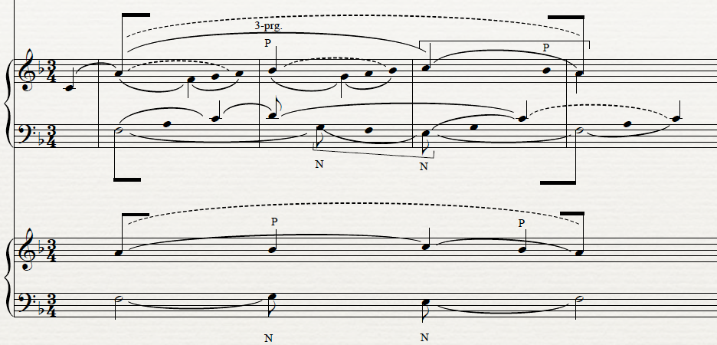
a middleground view

Slide 13
Harmonic sequences and Linear intervallic patterns
Linear Intervallic Patterns or LIP are directed intervallic patterns that appear between outer voices in free composition.
LIPs represent "directed tonal motion with complete precision and without ambiguity." [Forte and Gilbert, p. 84] They represent "in the most concise and intensive way the basic voice-leading motion of tonal music." [p. 89]

Slide 14
Linear intervallic patterns
LIPs can contain perfect and imperfect consonances as well as dissonances, according to the following categories:
imperfect-imperfect 10-10, 6-6, 10-6,
perfect-perfect 8-5
perfect-imperfect (or v. v.) 5-6, 6-5, 5-10, 10-5, 8-10
dissonance-imperfect (or v. v.) 10-7, 7-10, 7-6

Slide 15
The LIP is not part of the voice-leading indicated by the figured bass, though both are often used together to depict the entire voice-leading pattern of a composition.
Tip: don't use melody as a guide to LIPs! The LIP may be elaborated by additional diminutions (overlapping, CS, etc.), and the pattern itself may produce NN or CS.
Tip: a repeating pattern of the same diminution may help you locate an LIP.
Patterns may override the normative treatment of both horizontal and vertical dissonance, as in 8-5: an A4 in bass doesn't need to resolve, and 7—or the interval of a diminished 5—needn't resolve.

Slide 16
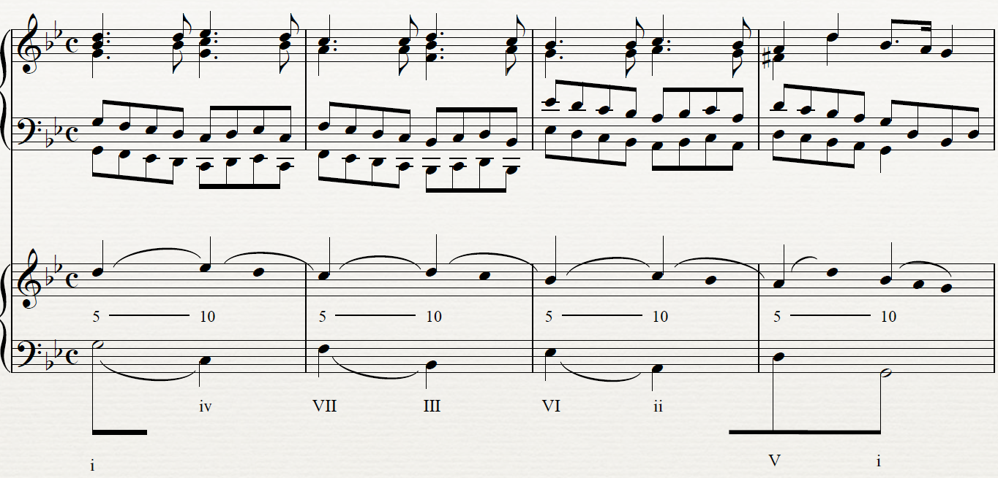
Handel passacaglia in g: theme

Slide 17
10
8
10
8
8
10
8

Slide 18
10
7
10
7
10
7
10

Slide 19
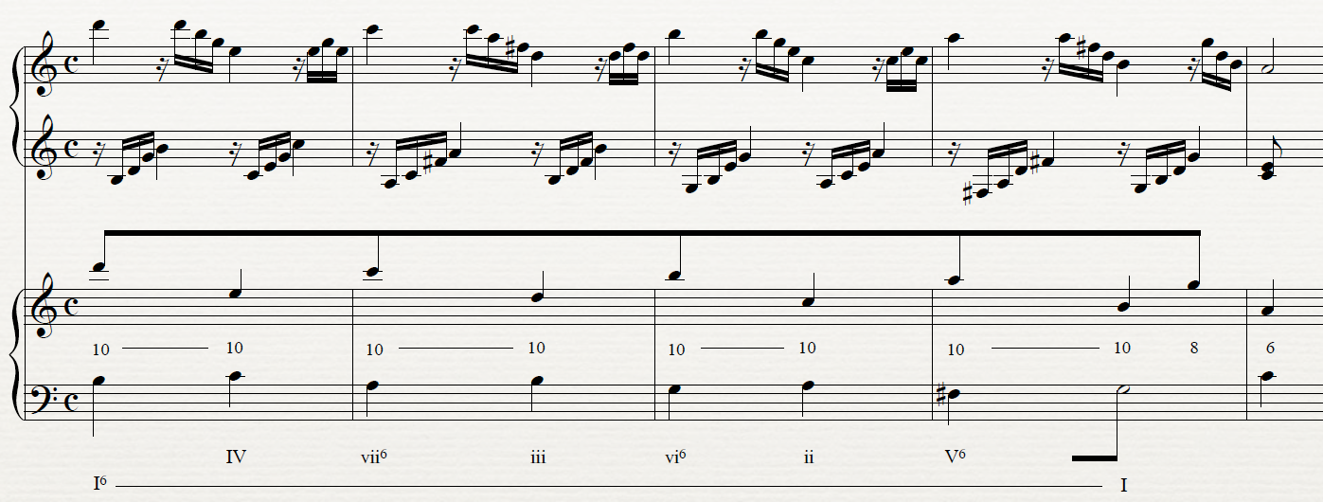
Mozart K. 545, I

Slide 20
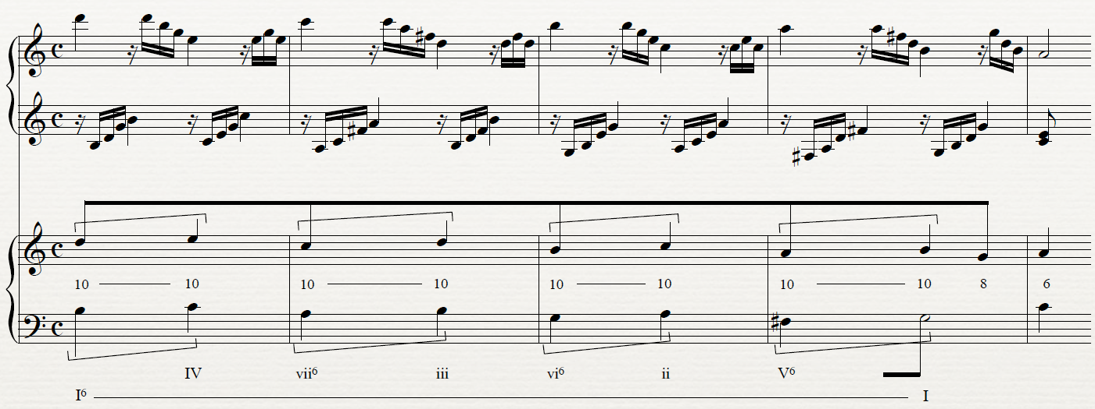
Mozart K. 545, I

Slide 21
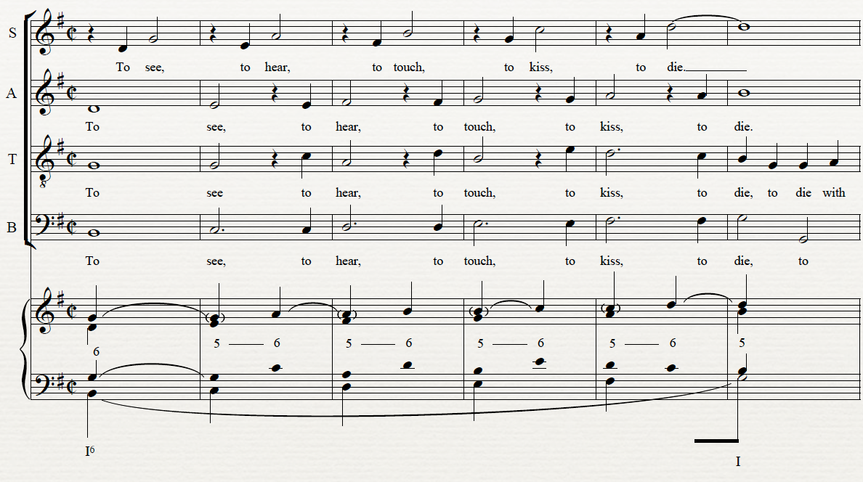
Dowland, “Come Again, Sweet Love”

Slide 22
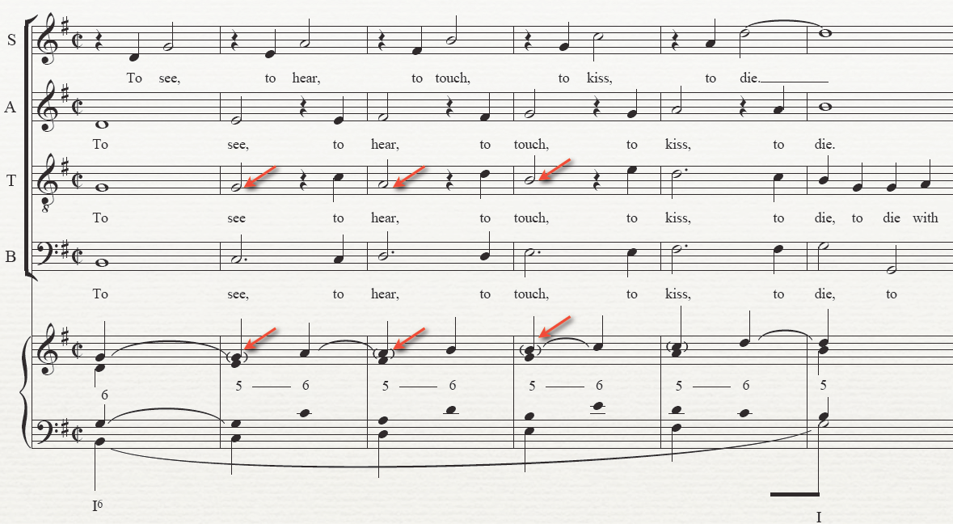
Dowland, “Come Again, Sweet Love”

Slide 23
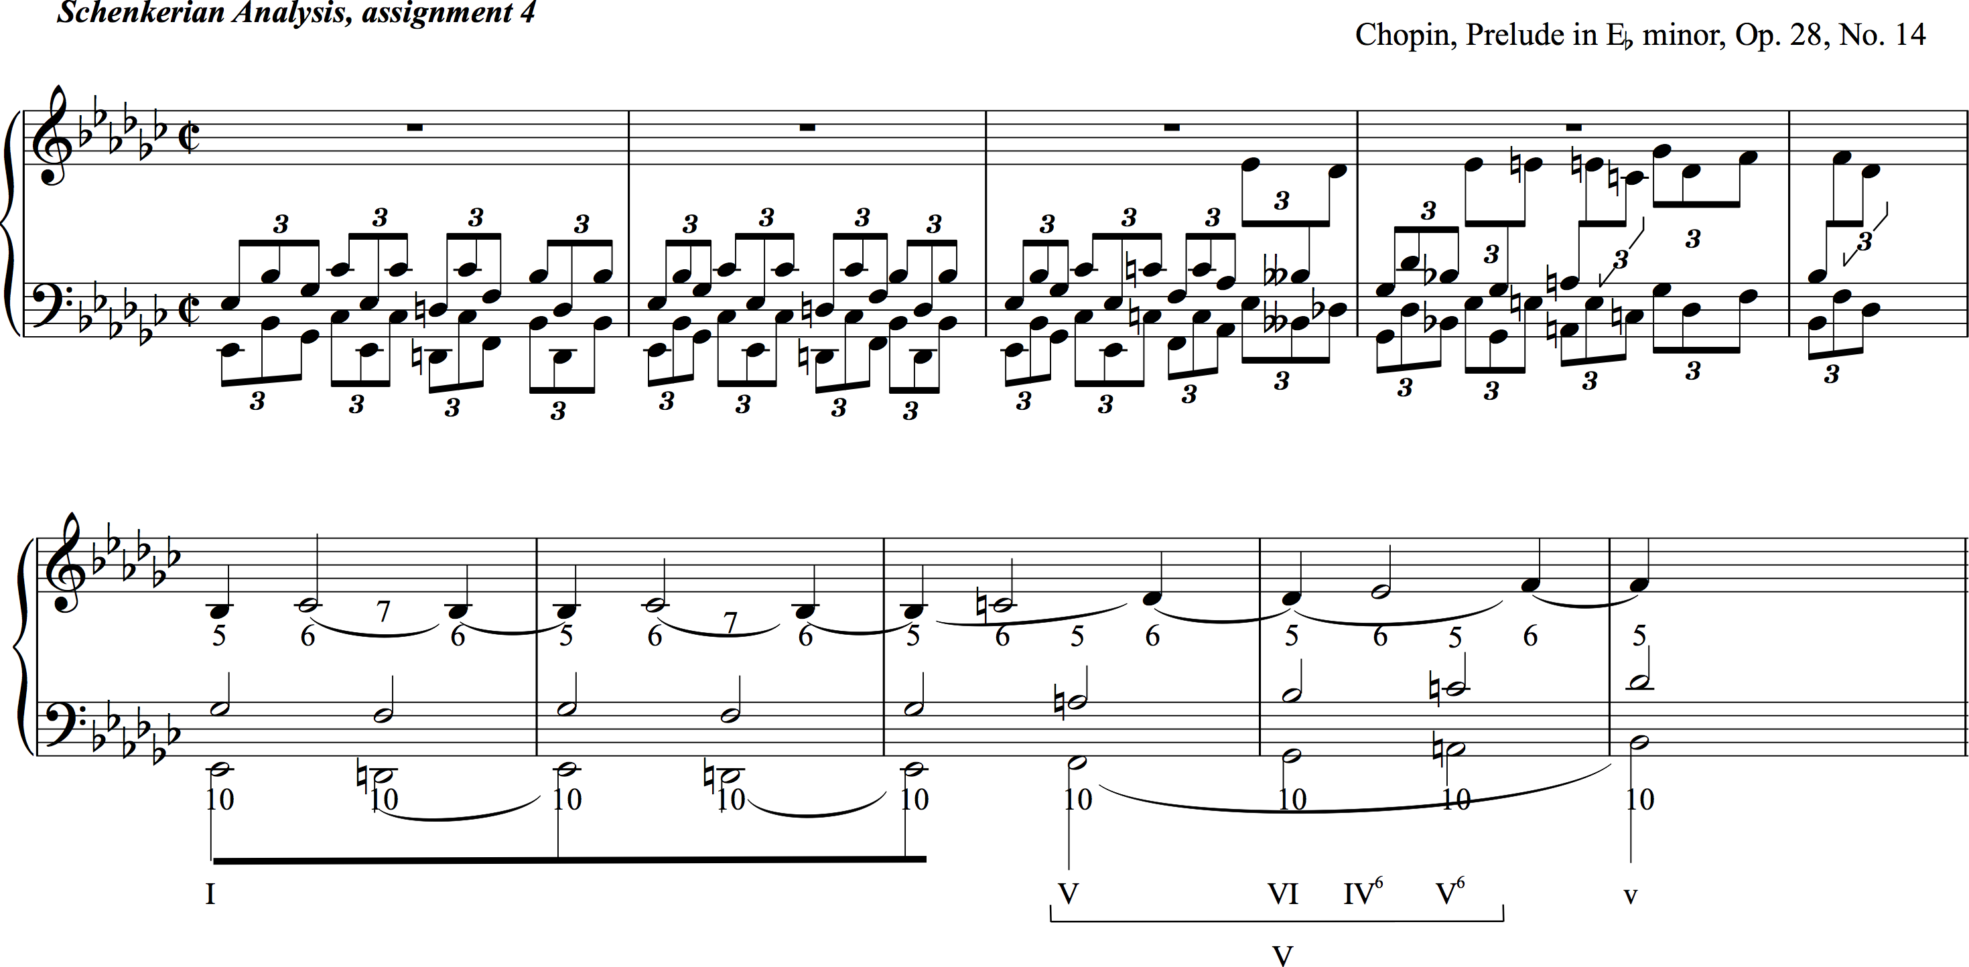

Slide 24
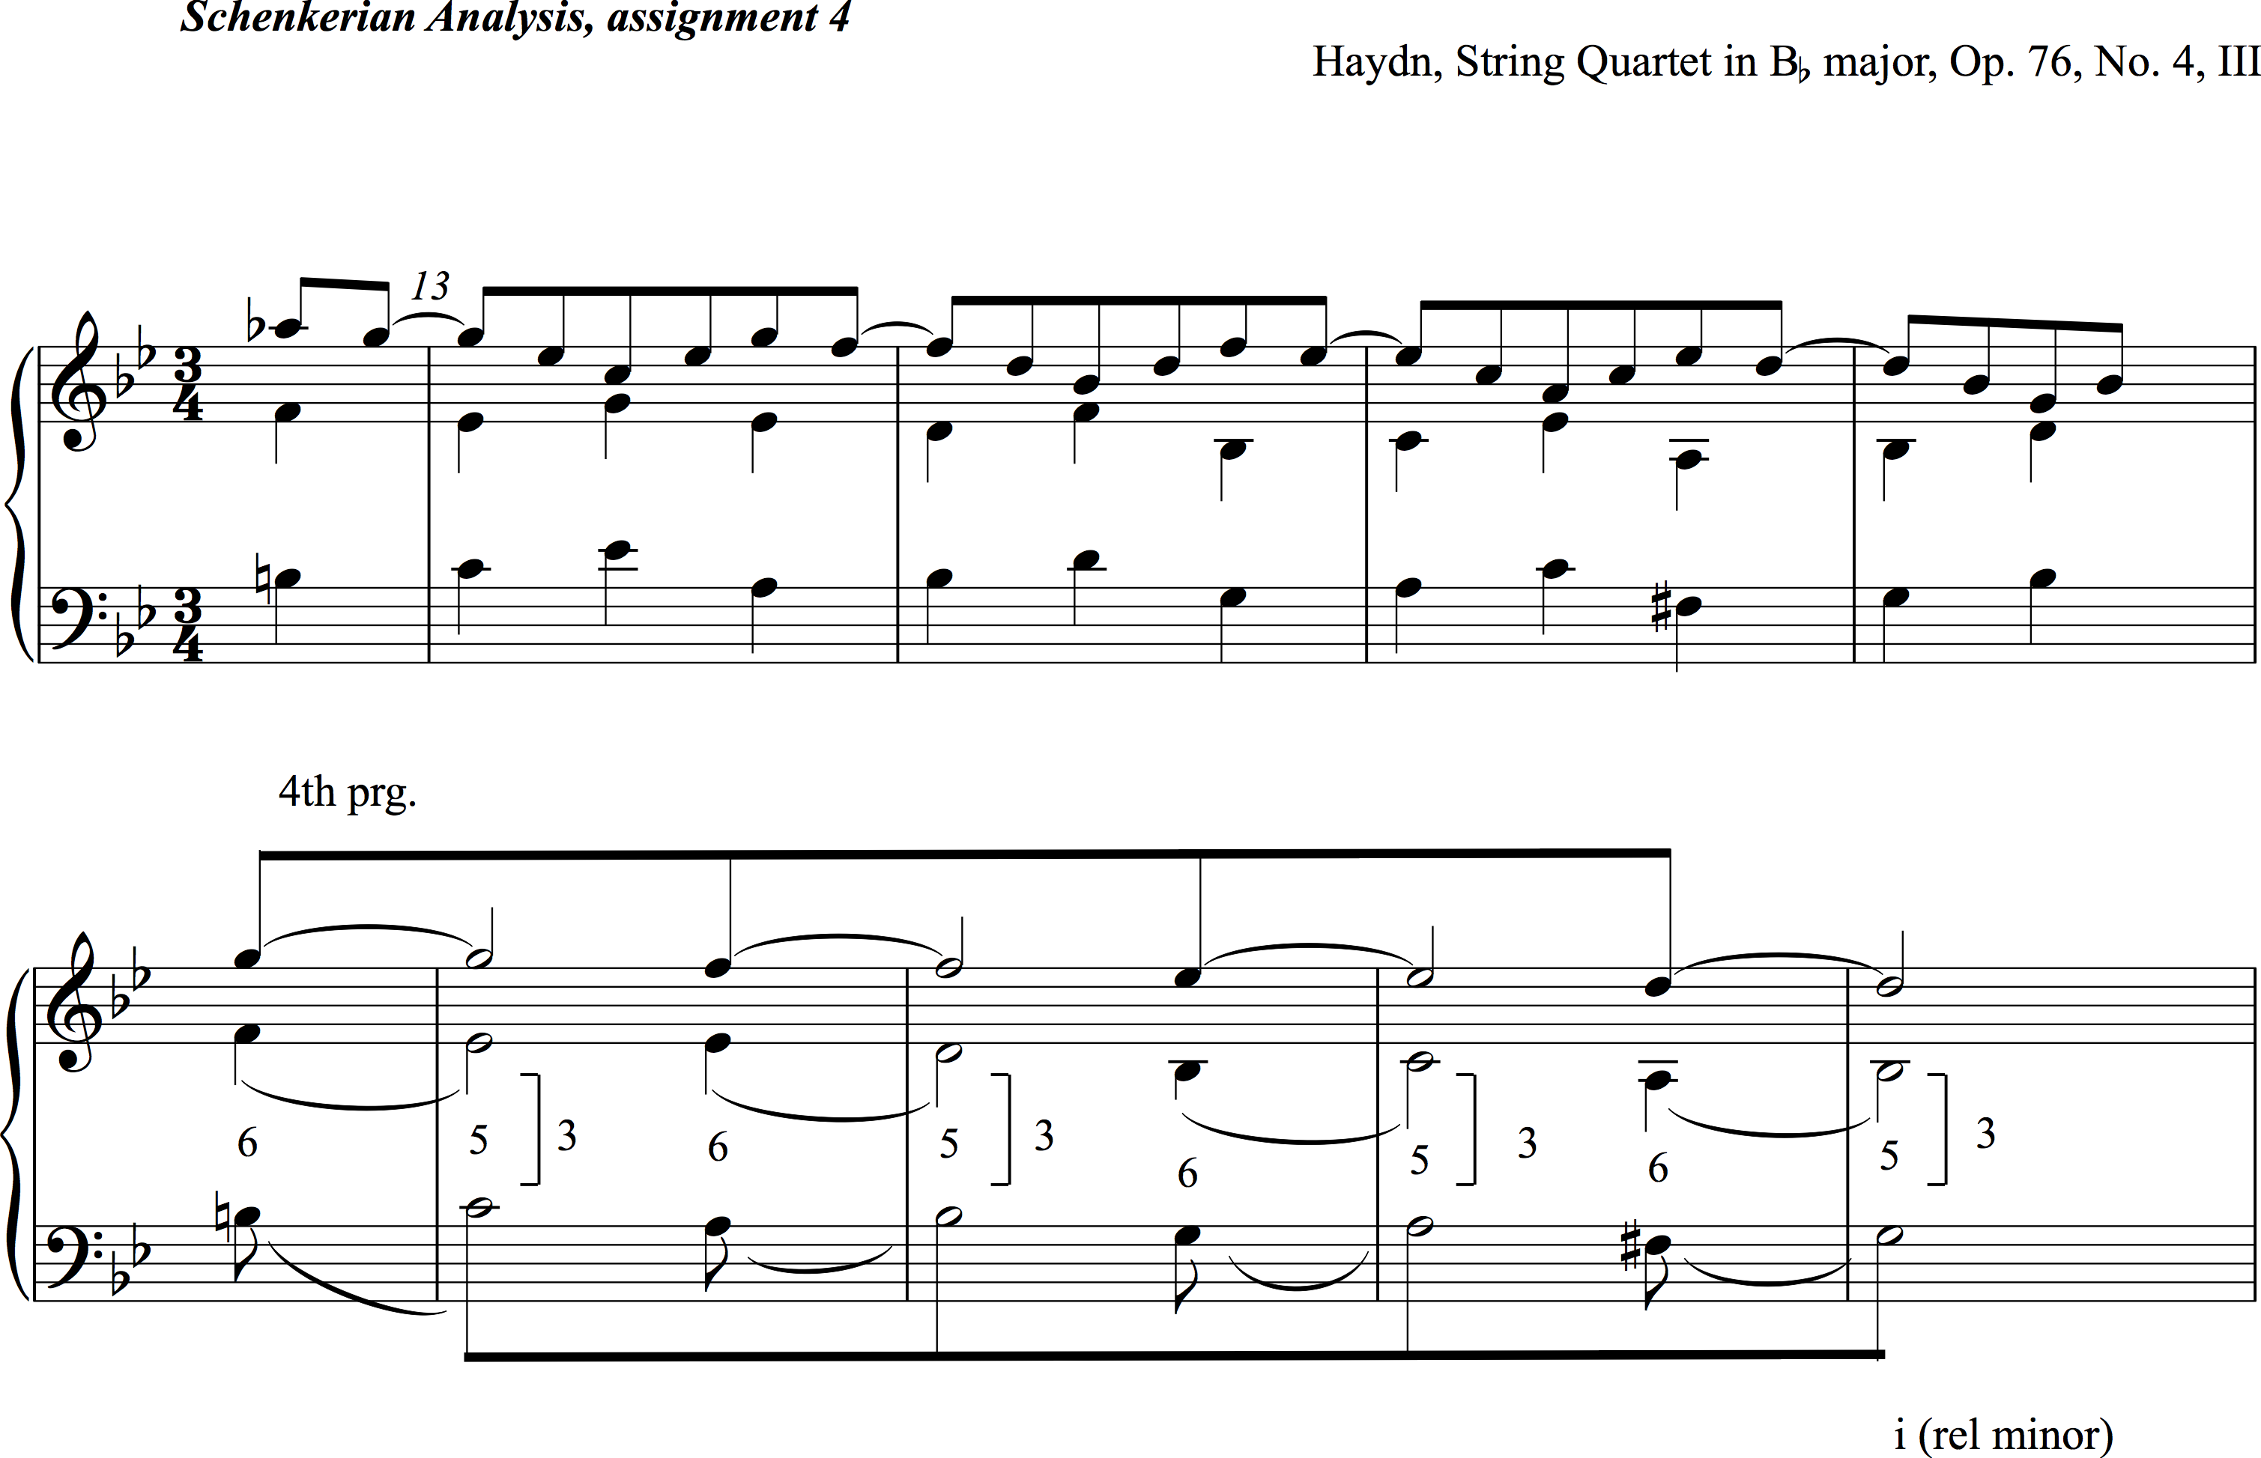

Slide 25
