Slide 1
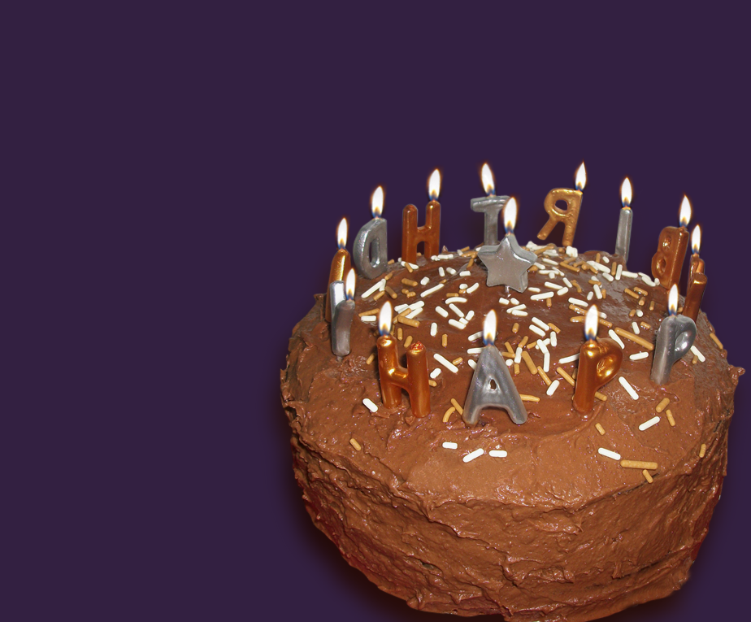
Happy Birthday
step-by-step

Slide 2
sentence or period?

Slide 3
6 - 5
7 - 6
I ⁶4 V V⁶ ⁵3 I
6 - 5
I⁶ IV ii°⁶ V[⁸⁶4 ⁻ ⁷⁵3 ] I

Slide 4
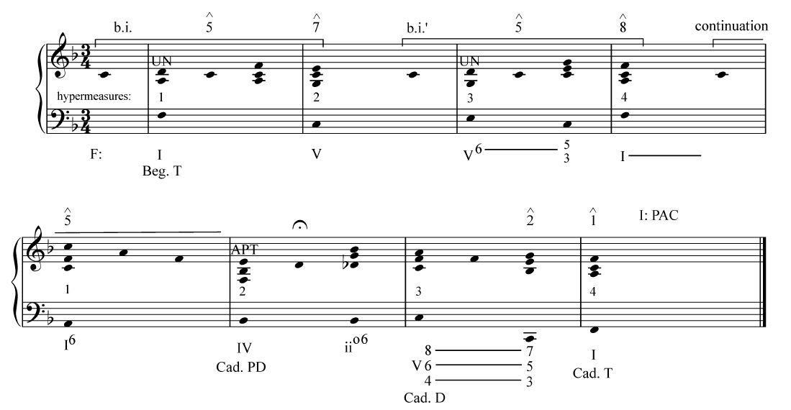
how would you graph the bass?

Slide 5
which voice dominates the soprano?
Arpeggiation hypothesis ~~~~
LN hypothesis ——-

Slide 6
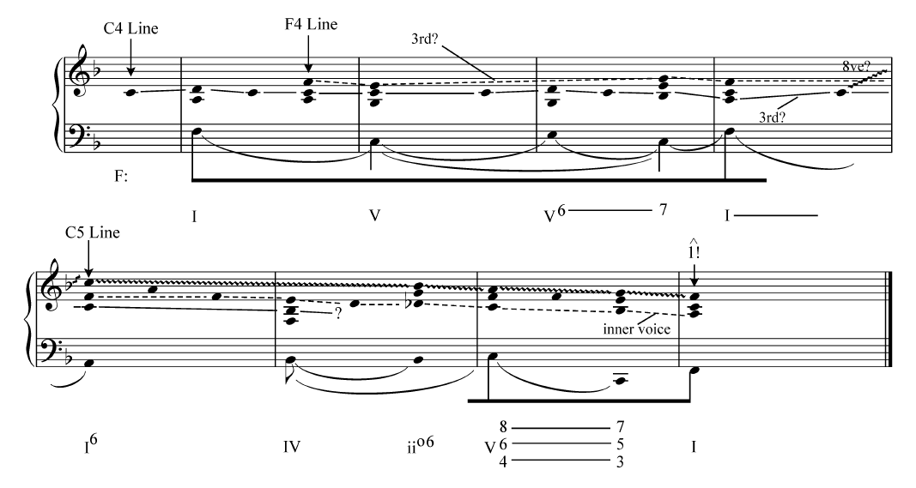
C4 hypothesis:
1.begins line
2. it gets an UN
3. repeated at the octave
F4 hypothesis:
1.attack points aligns with new harmonies
2. E4 and F4 emphasized
3. F4 higher than C4 in mm. 1–4
4. F4 line has more variety
C5 hypothesis:
1.highest pitch
2. metric emphasis, climax of phrase
3. contains cadential degrees ˆ2 and ˆ1

Slide 7
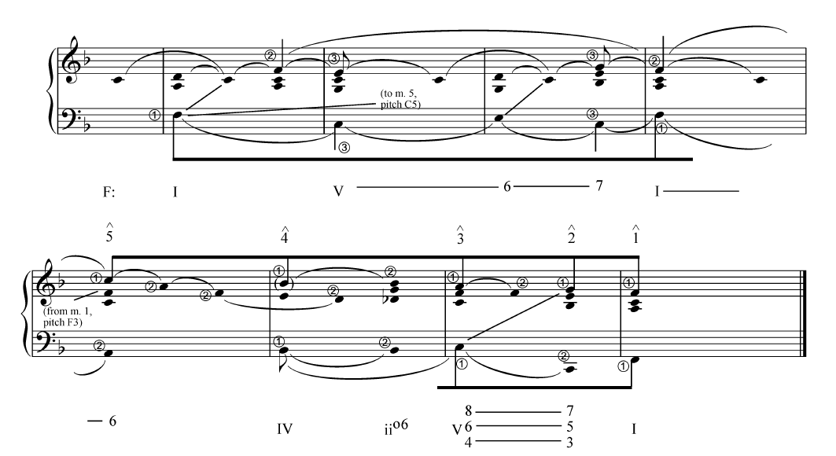
As a 5-line: CS up to ˆ5, gets lower and upper N
Each descending degree supported by a harmony

Slide 8
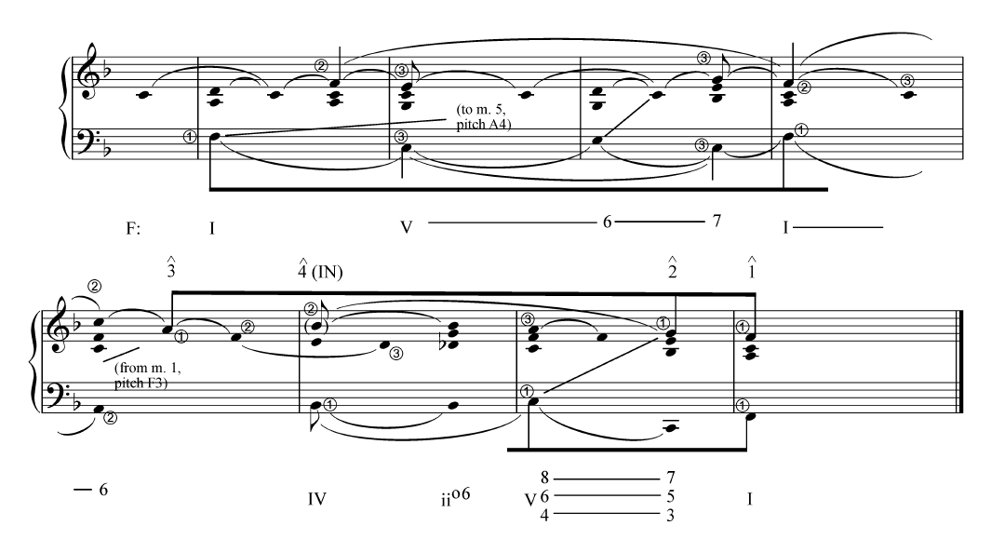
As a 3-line: arppegiation to ˆ3 (C5 just doubles inner C4)
ˆ4 becomes UN to ˆ3

