Slide 1
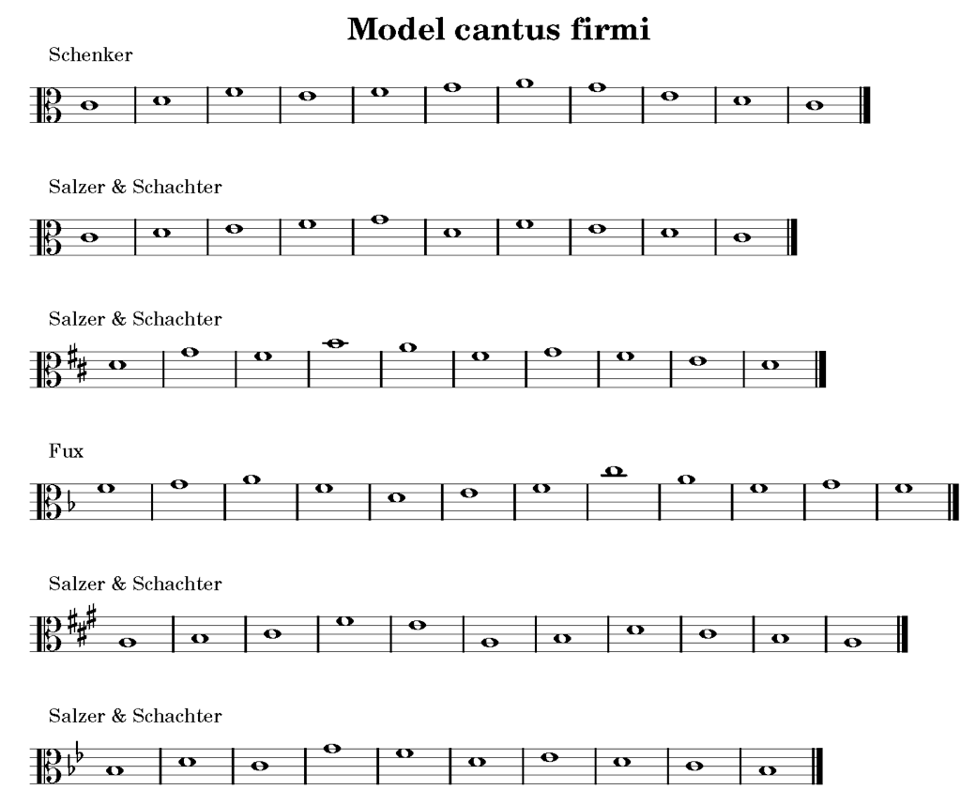

Slide 2
First Species

Slide 3
Second Species

Slide 4
Third Species

Slide 5
1
2
3
4

