Slide 1
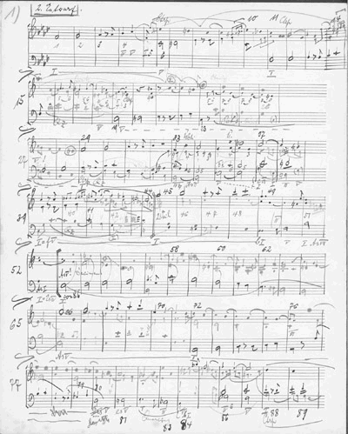
Introduction to Schenkerian Analysis
This course is an introduction to the theories and analytical techniques of Heinrich Schenker, as applied to eighteenth- and nineteenth-century Western music of the so-called “common practice” period.
Schenker's Basic Model

Slide 2
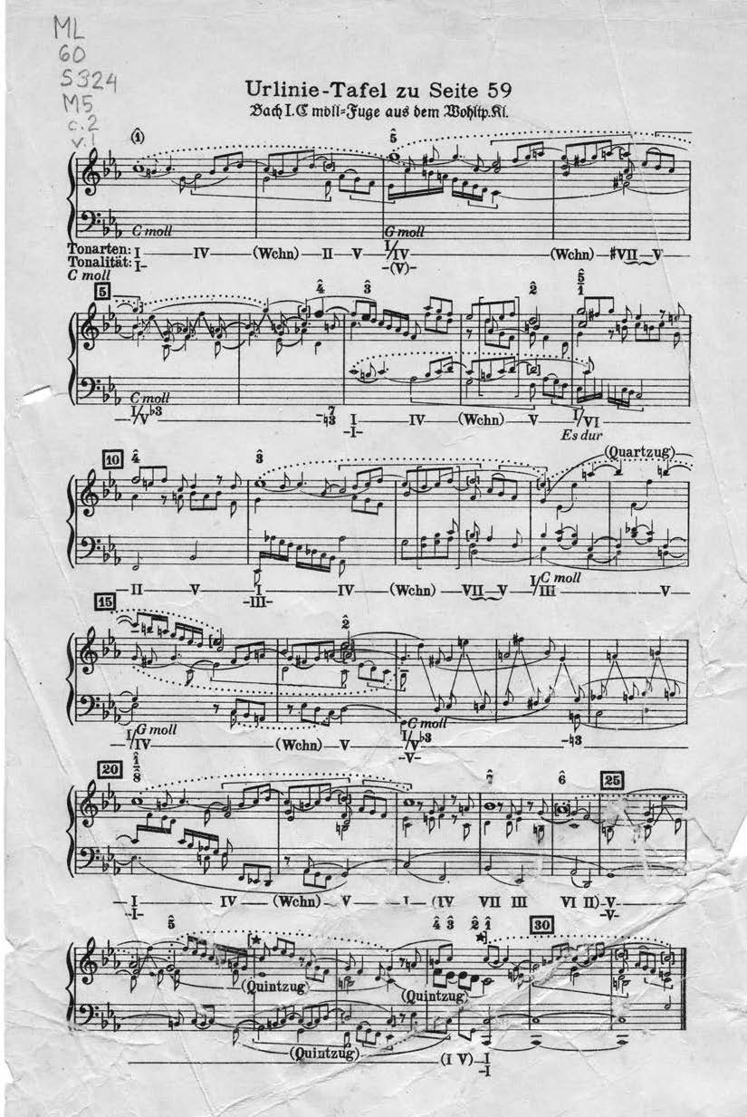

Slide 3
Topics in Schenkerian Analysis
Diminutions: the process by which an interval formed by notes of longer value is expressed by notes of shorter value. Diminutions include:
passing note P neighbor note N
consonant skip CS arpeggiation Arp
The note prolonged by a diminution need not actually be present
Theme and variations display diminutional procedures in tonal music
Diminution occurs as a prefix or suffix to main thematic material

Slide 4
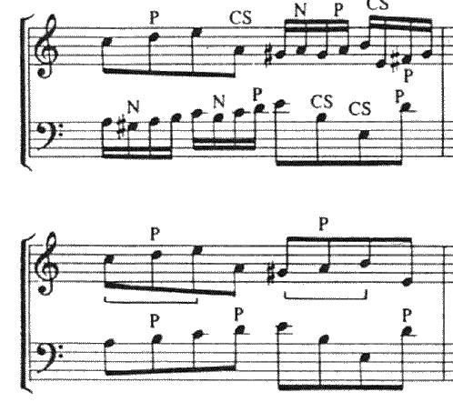
Rhythmic Reduction:
omits diminutions to reveal an underlying structural pattern
proceeds by doubling the smallest submetrical value in written piece.

Slide 5
Analytic Notation
Slurs indicate dependency, stems indicate main notes

Slide 6
Neighbor Note: complete: departs from dependent note and returns to it
incomplete (doesn't return; usually found only as prefix, not suffix, unless continued in another voice).

Slide 7
Elementary type diminutions often occur in durationally expanded form, predicated on the fundamental concept the function of a note is determined by its harmonic and contrapuntal setting
Diminutions often displace the notes on which they're dependent, so that musical elements that should be found together appear in different temporal locations, and indirect NN figures--in which NN isn't adjacent to dependent note--are common

Slide 8
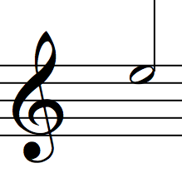
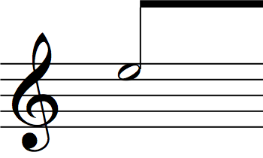
More on Notation
Half-notes for tones of fundamental line and fundamental bass line.
Beams connect tones of the fundamental line, beginning and end of significant bass progressions, replicas of the fundamental line in the middleground

Slide 9
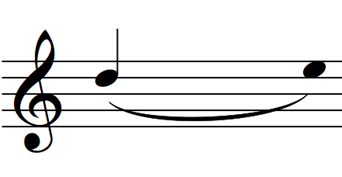
More on Notation
Stemmed noteheads are used for significant middleground lines
Unstemmed noteheads are dependent on those of greater structural importance

Slide 10
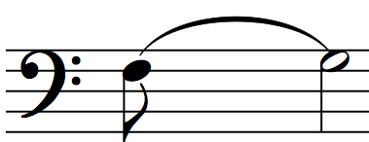
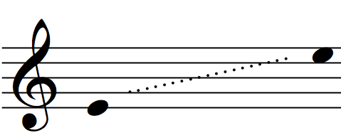
More on Notation
Flags are used for structurally-important neighbors (i.e. harmonic/contrapuntally-supported, as in IV-V), and long-range metric events (Schenker’s use)
Dotted lines indicate Register Transfer
All other dependent notes indicated by slurs

Slide 11
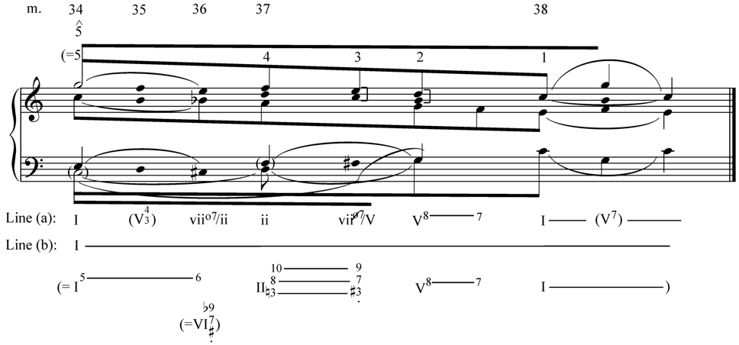
Schenker’s harmonic view vs ours

Slide 12
