Slide 1
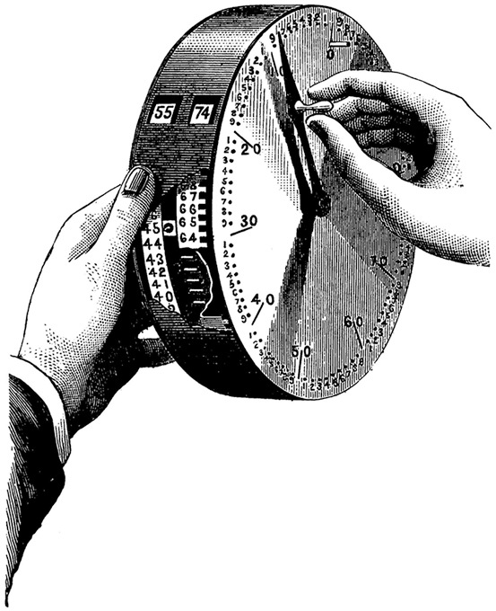
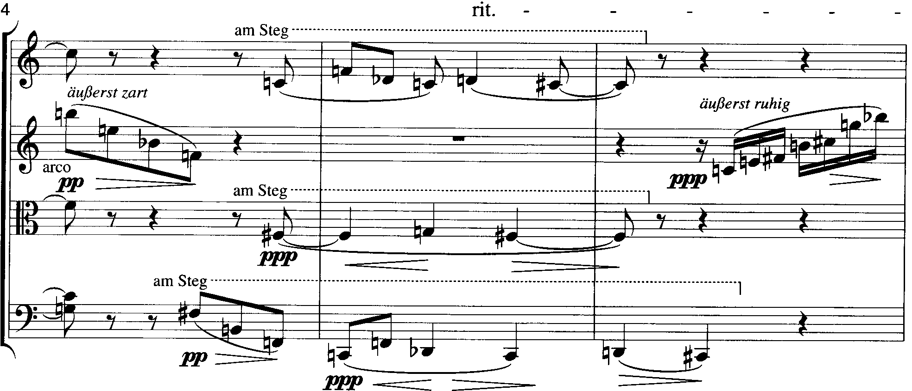
PC Set Theory & Analysis
Chapter 2

Slide 2
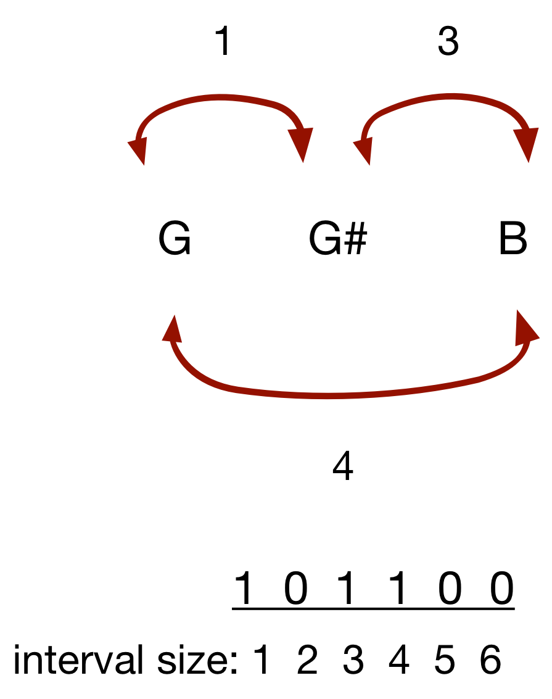
Review of interval class and vector

Slide 3
G G# B in 6 different spacings
B | G# | B | G# | G | G
G# | B | G | G | B | G#
G | G | G# | B | G# | B
[1] [3] | [4] [9] | [11][4] | [8] [1] | [2] [8] | [9][11]

Slide 4
Interval Class Vector
A representation of the complete interval content of a set in terms of interval class
0, 1, 3, 4
1-0 = 1, 3-0=3, 4-0=4
3-1 = 2, 4-1 =3
4-3=1
Two 1, one 2, two 3, one 4, no 5, no 6
[212100]

Slide 5
Interval Class Vector
The triangle of differences dumps the 0, but includes the numbers in the set
0, 1, 3, 4
3-1 = 2, 4-1 =3
4-3=1
Two 1, one 2, two 3, one 4, no 5, no 6
[212100]

Slide 6
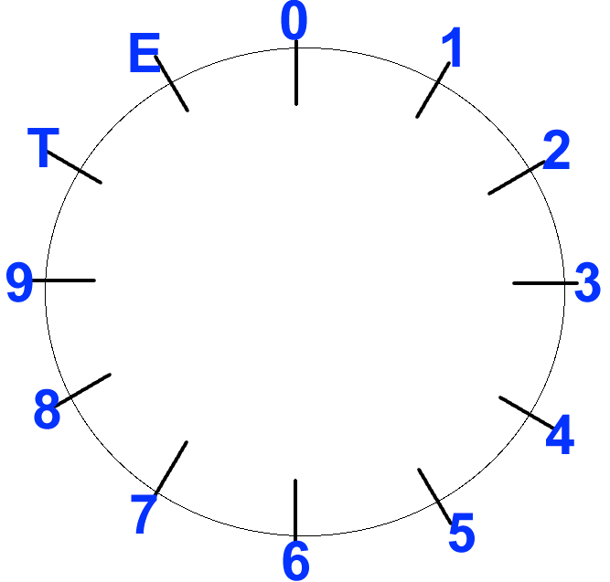
PC clock face: transposition by ordered pitch interval (opi)
pc0 + i4 = pc4
pc4 + i4 = pc8
pc8 + i4 = pc0

Slide 7
PC clock face: transposition by ordered pitch interval (opi)
pc0 + i13 = pc1
pc0 + i17 = pc5

Slide 8
PC clock face: transposition by unordered pitch interval, or interval-class (ic)
pc0 + i13 =
Pc0 + ic1 = pc1
pc0 + i17 =
Pc0 + ic5 = pc5

Slide 9
Interval class: shortest distance between any two pcs
pcT + i4 = pc2
pc2 + i8 = pcT
pc2 - i4 = pcT

Slide 10
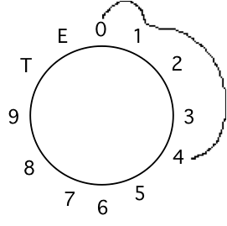
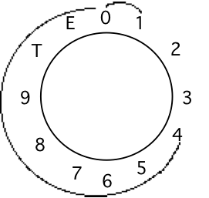
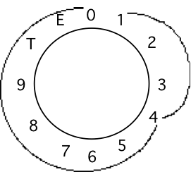
Normal Form:
rotation of the set that preserves the smallest interval between first and last pitch
Given E, C#, B# = 4, 1, 0
Chronologically:
4, 0, 1
0, 1, 4
1, 4, 0
NF = 0, 1, 4
distance from 1 to 0 = 11
distance from 4 to 1 = 9
distance from 0 to 4 = 4

Slide 11
Normal Form
What if a set seems to have more than one normal form?
1,4,7,T = 3-3-3-(3)
5,7,E,1 = 2-4-2-(4)
Use the lowest number

Slide 12
Transpositional Equivalence
How do we tell if two sets of the same cardinality are transpositionally equivalent (can be mapped onto one another)?
Find their Normal Order
Subtract the first pitch of set A from the first pitch of set B (this will be your transpositional operator)
Add that number to every pitch in set A;
if you produce set B, they are equivalent sets (the same pitch-class set)

Slide 13
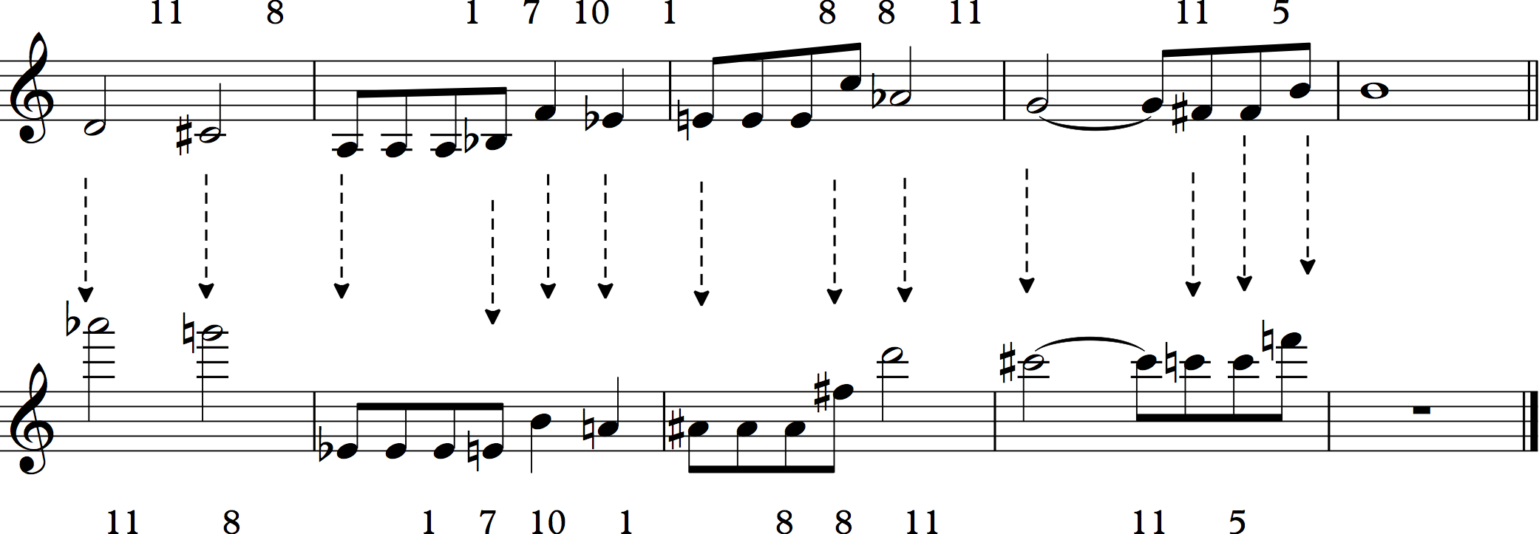
Transposing a melody
what is the Tn level?
T6

Slide 15
Recognizing sets as transpositionally related
Given twos set, how do you determine if they are related by transposition?
F, G, Ab, B vs. C#, Eb, Fb, G

Slide 16
Transpositional Equivalence
Set [147T] and
Set [0369]
0-1 =11
1+11=0,
4+11=3,
7+11=6,
T+11=9
[147T] at T₁₁ = [0369]
The sets are equivalent, at not one but 4 transposition levels (T₀ is trivial)

Slide 17
Transpositional Equivalence
Set [147T] and
Set [57E1]
5-1 =4
1+4=5,
4+4=8,
7+4=E,
T+4=2
[147T] at T4 = [258E]
The sets are not equivalent, although they share two intervals

Slide 18
Nodes, arrows and Networks
Chords
PC sets
Db Major
T³
F Major
T³
0, 2, 3, 5
3, 5, 6, 8

Slide 19
Inverting a melody
what is the In level?
I9

Slide 20
Inversional Equivalence
How do we tell if two sets of the same cardinality are inversionally equivalent (can be mapped onto one another by inversion followed by transposition)?
Find their Normal Order
Determine the adjacency interval series for each set
Are these AIS mutually retrogradeable (is one the reverse of the other)?
if opposite members of each set sum to the same number, the are inversionally equivalent

Slide 21
Inversional Equivalence
Set [890] and Set [034]
[890] = 1-3; [014] = 3-1
8+4=0,
9+3=0,
0+0=0,
[890] at T₀I = [034]
The sets are inversionally equivalent

