Slide 1
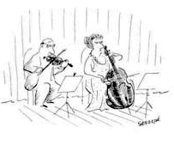
Pitch-class sets:
Further relations and properties

Slide 2
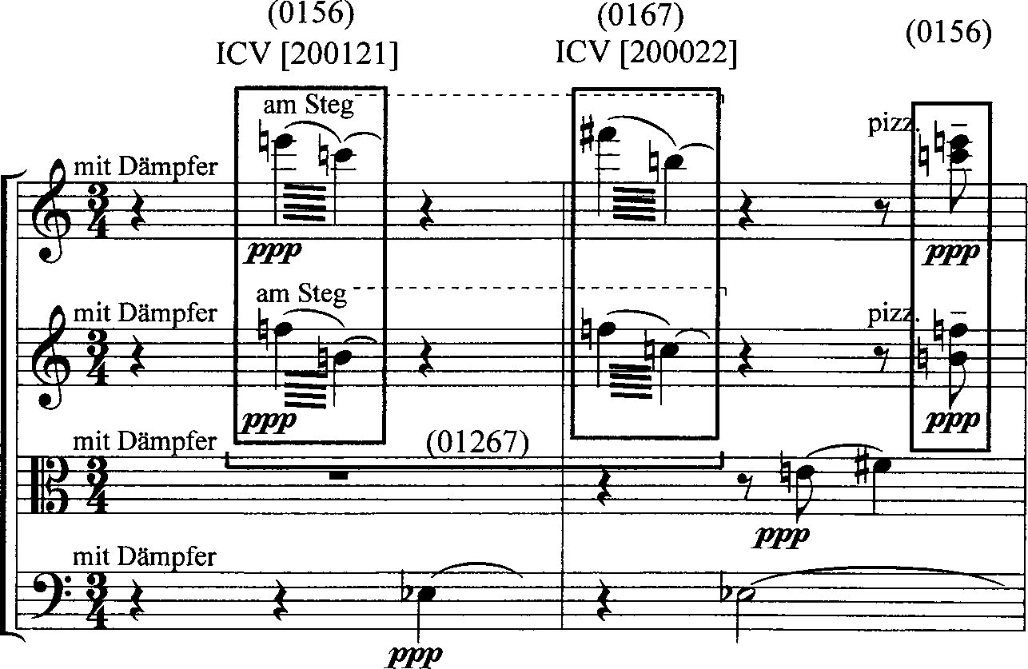

Slide 3
Invariant Tones under Transposition
The number of Common tones that occur at a specific transposition level
Equal to the number of times N occurs in the set (except at ic6, which will be multiplied by two, as each tritone maps into the other)

Slide 4
Chords in mm. 1-6 of Op. 5, III

Slide 5
Examples of Invariant Tones under Transposition
024 <020100>
at T₁, T₃, T₅ and T₆ there are no CT
[024] at T₁ = [135]
[024] at T₃ = [357]
[024] at T₅ = [579]
[024] at T₆ = [68T]
at T₂ there are 2 CT
[024] at T₂ = [246]
at T₄ there is 1 ct
[024] at T₄ = [48T]

Slide 6
Because it is an ICV
This will work for each interval and its complement
at T₁₁, T₉, T₇ there are no CT
[024] at T₁₁ = [E13]
[024] at T₉ = [9E1]
[024] at T₇ = [79E]
at T₁₀ there are 2 CT
[024] at T₁₀ = [T02]
at T₈ there is 1 ct
[024] at T₁ = [8T0]

Slide 7
More Examples
[0347] <102210> = at T₁, 1 CT
At T₁ , 1 CT: [1458]
At T₂ , 0 CT: [2569]
At T₃ , 2 CT: [367T]
At T₄ , 2 CT: [478E]
At T₅ , 1 CT: [5890]
At T₆ , 0 CT: [69T1]

Slide 8
More Examples
[016] <100011>
At T₁, 1 CT: [127]
At T₅, 1 CT: [56E]
but at T₆, 2 CT: [670]

Slide 9
The interval vector shows pitch hierarchy
Interval Vector of 7-35 (013568t) <254361>
Unique multiplicity of interval class hierarchy: Tn level determines the closeness of the tonality to the tonic (as opposed to, say, WT)
If the interval vector entry numbers = # of cardinality, then the set-class maps into itself under Tn (1/2# in 6)
0369 <004002> maps into itself under EITHER 3 or 6

Slide 10
Invariant Tones under Inversion
The sums of each pair of elements in the set
For each sum, there are two common tones under TnI for that n
Inversion often leads to pc invariance. But, this operation needs to be considered in combination with transposition
TnI represents a transposition n of the inversion
Build a summation square to determine common tones under inversion

Slide 11
Invariant Tones under Inversion
 | 0 | 1 | 4 | 8
0 | 0 | 1 | 4 | 8
1 | 1 | 2 | 5 | 9
4 | 4 | 5 | 8 | 0
8 | 8 | 9 | 0 | 4

Slide 12
12 unique sums, 12 indices
T₀I =3 T₆I =0
T₁I =2 T₇I =0
T₂I =1 T₈I =3
T₃I =0 T₉I =2
T₄I =3 T₁₀I =0
T₅I =2 T₁₁I =0

Slide 13
[0148]
T₀I =3 [48E0]
T₁I =2 [5901]
T₂I =1 [6T12]
T₃I =0 [7E23]
T₄I =3 [8034]
T₅I =2 [9145]

Slide 14
[0148]
Value of n in T_{n}I and Index vector for [0148]:
0 1 2 3 4 5 6 7 8 9 10 11
<3, 2, 1, 0, 3, 2 0, 0, 3, 2 0, 0>
Index vectors derived from particular normal orders, not from prime forms

Slide 15
0347
 | 0 | 3 | 4 | 7
0 | 0 | 3 | 4 | 7
3 | 3 | 6 | 7 | 10
4 | 4 | 7 | 8 | 11
7 | 7 | 10 | 11 | 2

Slide 16
What does the table tell us?
The numbers within the table are the sums at the intersections of the pcs.
By tallying these numbers we can ascertain the invariant pcs under TnI. For example, the two 11s reveal that there are 2 common pcs at T₁₁I.
Further, the table tells us which pcs are invariant under this T: those that create the intersection: 4 and 7.
The two 3s indicate 2 common pcs at T₃I, and they are 0 and 3, etc.

