Slide 1
Triadic Post-tonality
Neo-Riemannian

Slide 2
Klangs
In NRT, triads are considered ordered pc sets and are referred to as Klangs: an ordered pair (p, sign), where p is a pitch class and sign takes on the values + and – for major and minor

Slide 3
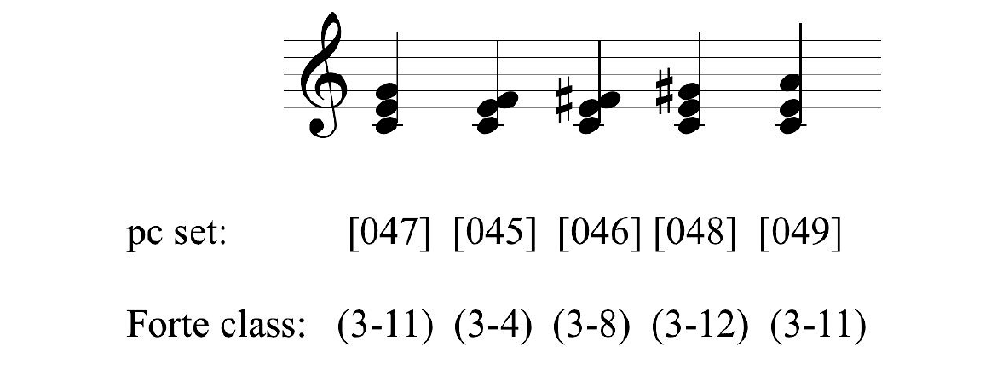
Parsinomious voice-leading
Cohn’s 1997 article, “Neo-­‐Riemannian Operations, Parsimonious Trichords, and Their ‘Tonnetz’,” introduced the term parsimony.
(1) two voices are retained as common tones, and (2) the third voice proceeds by an interval no greater than twice the smallest available interval in a given tuning.
Examples of parsimonious voice leading among pc sets

Slide 4
Basic triadic Transformations
A parallel transformation converts a major triad to the minor and vice versa by moving the third by half-­step.
A relative transformation converts a major triad to a minor triad by moving the fifth a whole-­‐step up and moves a minor triad to a major triad by moving the root down by whole-­step.
The leading­‐tone exchange transformation converts a major triad to a minor triad by moving the root down by half-step, and vice versa, from minor to major by moving the fifth up a half­-step to become the root of the resulting triad.

Slide 5
Basic triadic transformations
Each transformation an involution; each is mode-altering; and each transformation preserves two common tones, replacing the third with a pc a semitone away (in the case of P and L) or a whole tone away (in the case of R).
Mode‐altering can be thought of as the inversion of the triad; thus, [047] becomes [037] or vice versa.

Slide 6
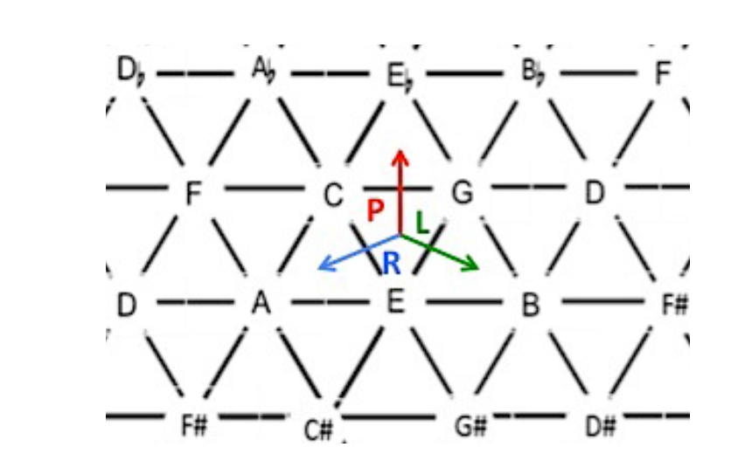
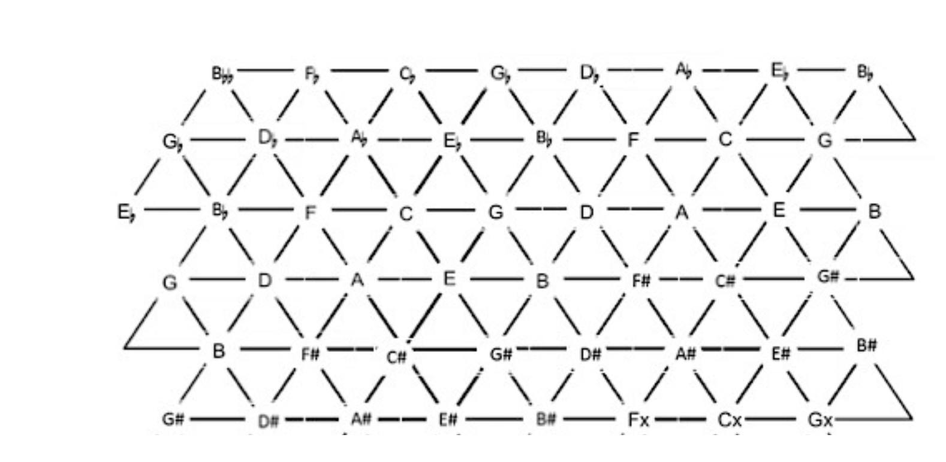
The Tonnetz
A two‐dimensional graph in which the axes represent the three intervals of a trichord
Because they are involutions, the tonnetz includes only major and minor triads

Slide 7
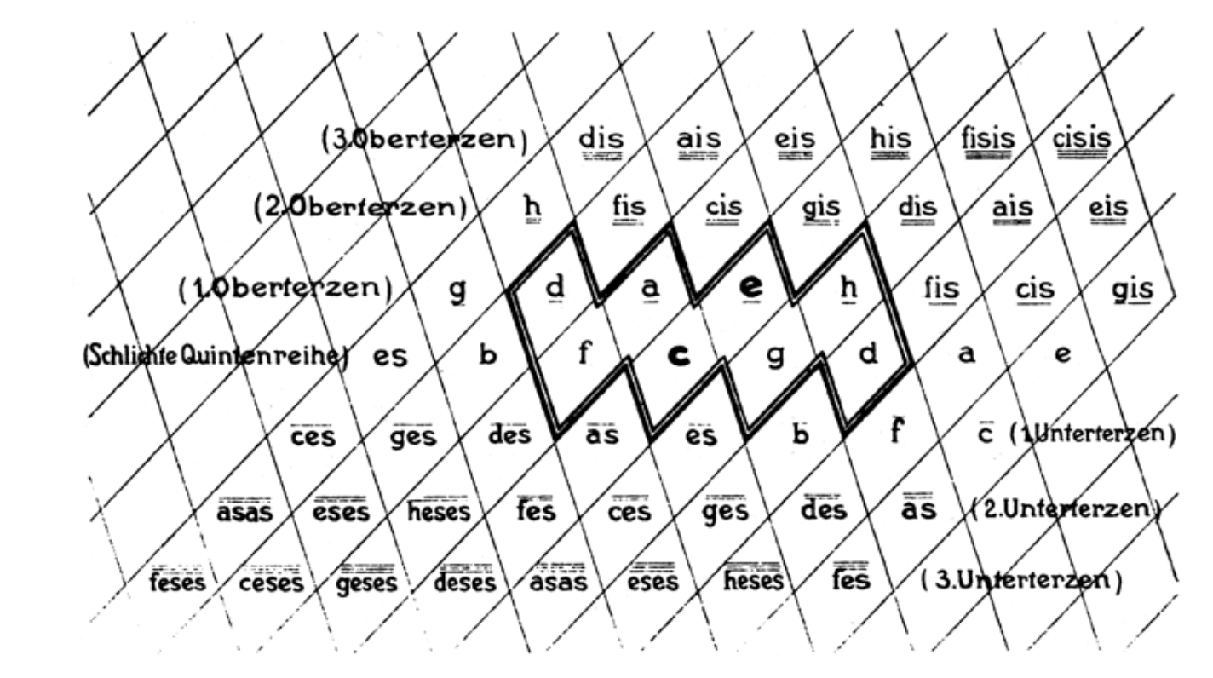
Riemann’s Tonnetz

Slide 8
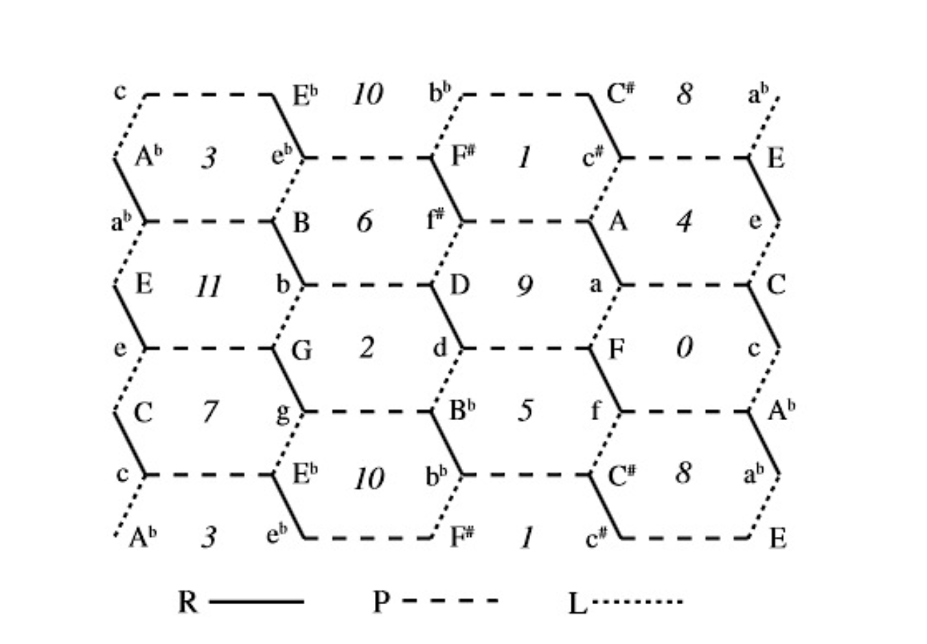
parallel
relative
leading-tone
Jack Douthett and Peter Steinbach’s chickenwire Tonnetz shows the relationship of triads through the use of root-named chords

Slide 9
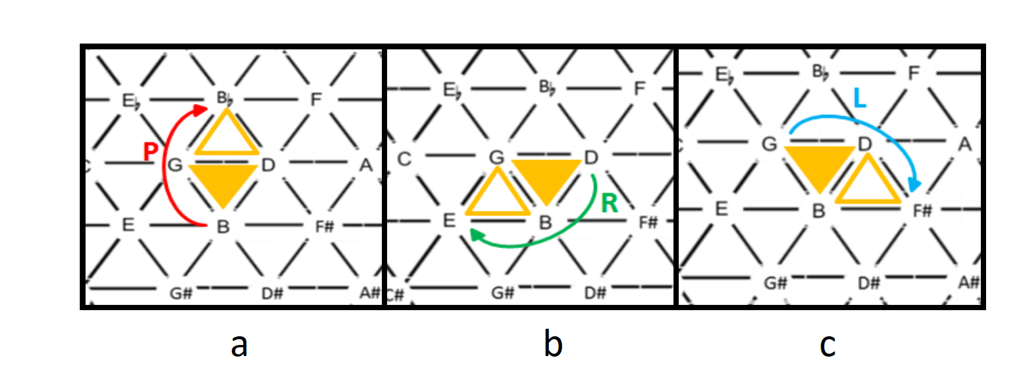
To navigate the Rieman/Hyer Tonnetz, chords are transformed by changing one pitch at a time.

Slide 10
C+
E-
C+
E-
L
L
Analyze this example from Prokofiev’s Fugitive Visions

Slide 11
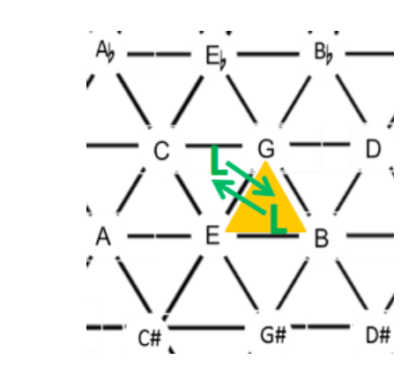
Answer Prokofiev’s Fugitive Visions

Slide 12
PL cycle hexatonic

Slide 13
Further transformations
P’ = SLIDE invert around the third: C+ C#-
L’ root of major becomes fifth of minor and v.v.:
C+ F-
R’ fifth of major becomes root of minor and v.v.:
C+ G-

Slide 14
Combining transformations
LP cycle is hexatonic:
C+, E-, E+, G#-, Ab+, C-, C+
PLR cycle: six triads that all share one pitch:
C+, C-, Ab+, F-, F+, A-, C+

Slide 15
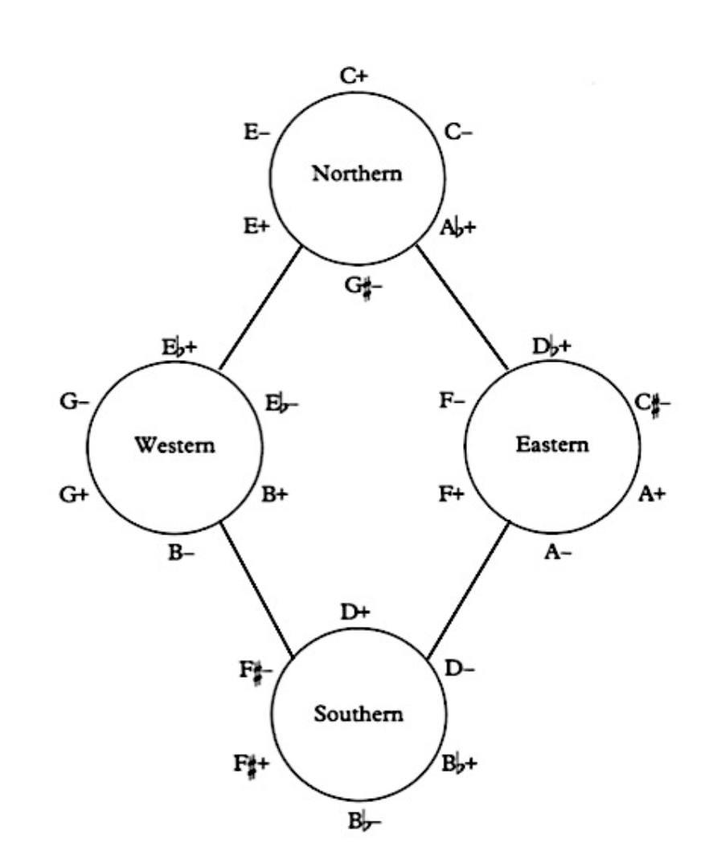
Cohn’s hyperhexatonic system: PL

Slide 16
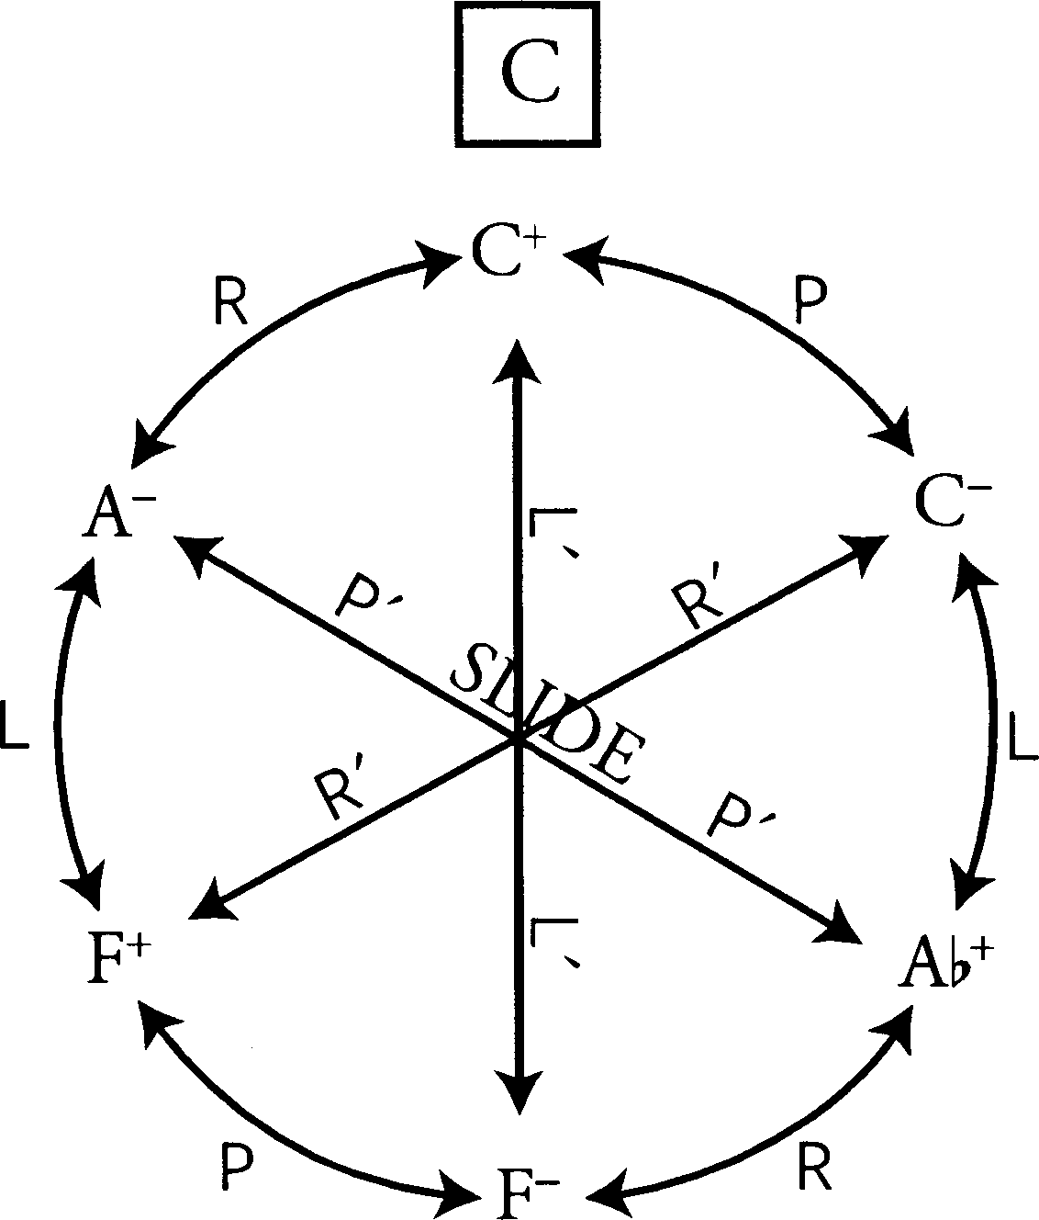
PLR cycle

Slide 17
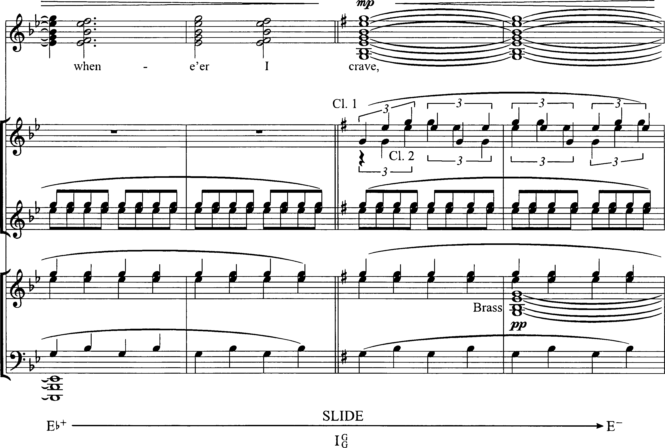
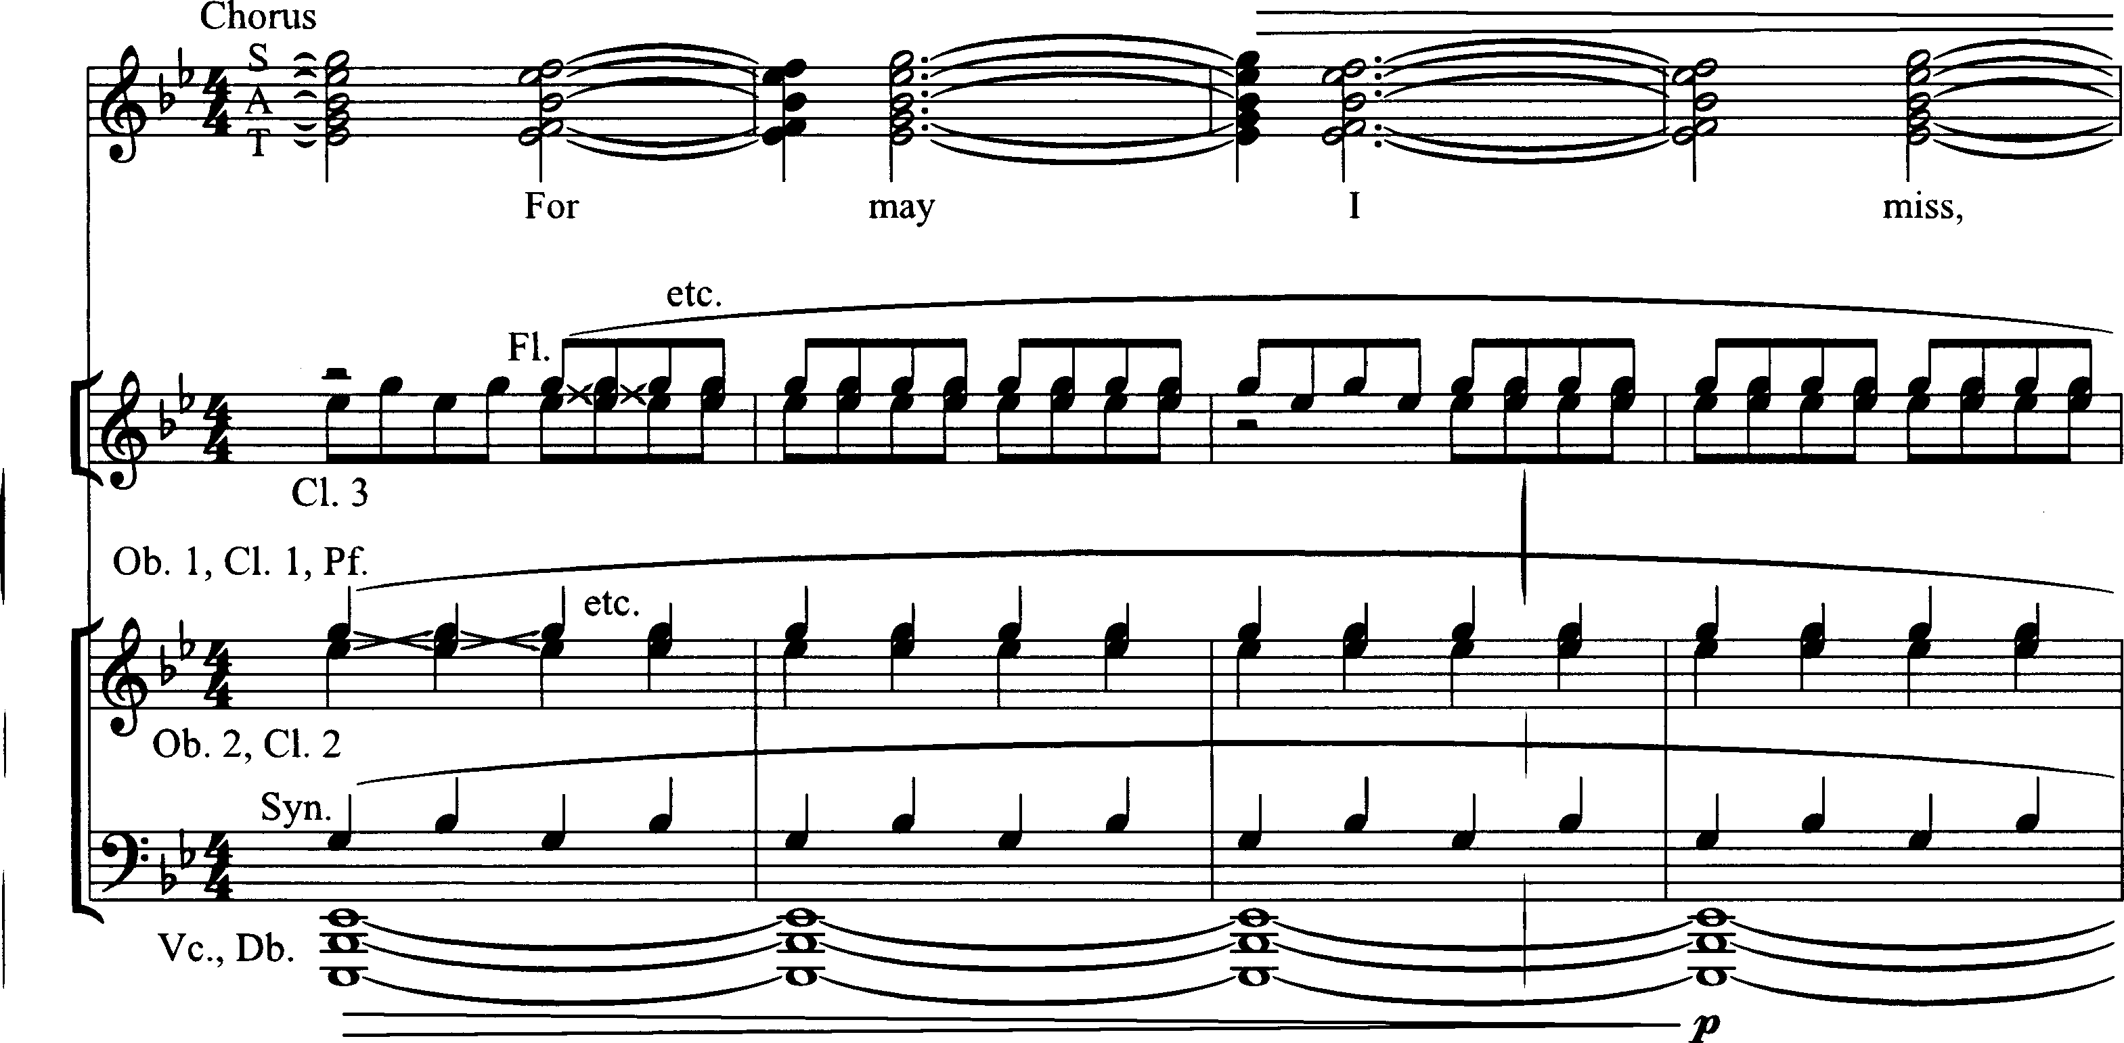

Slide 18
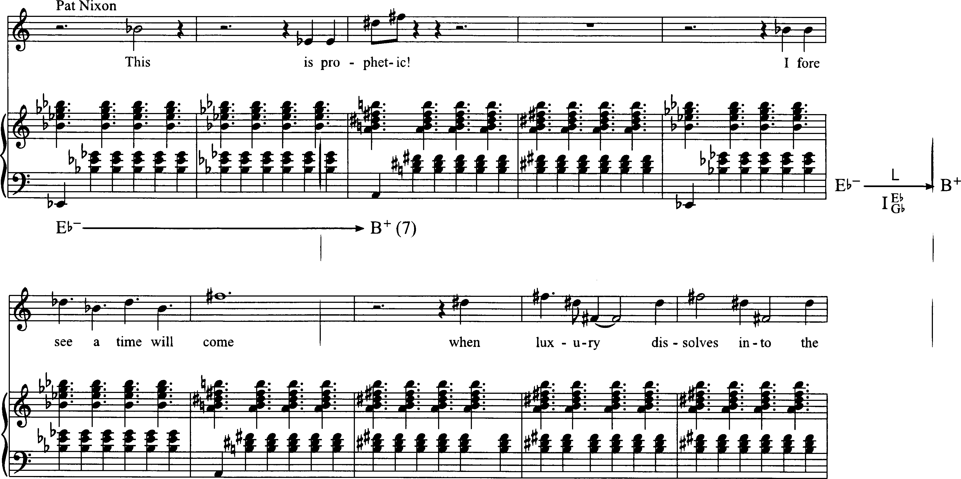

Slide 20
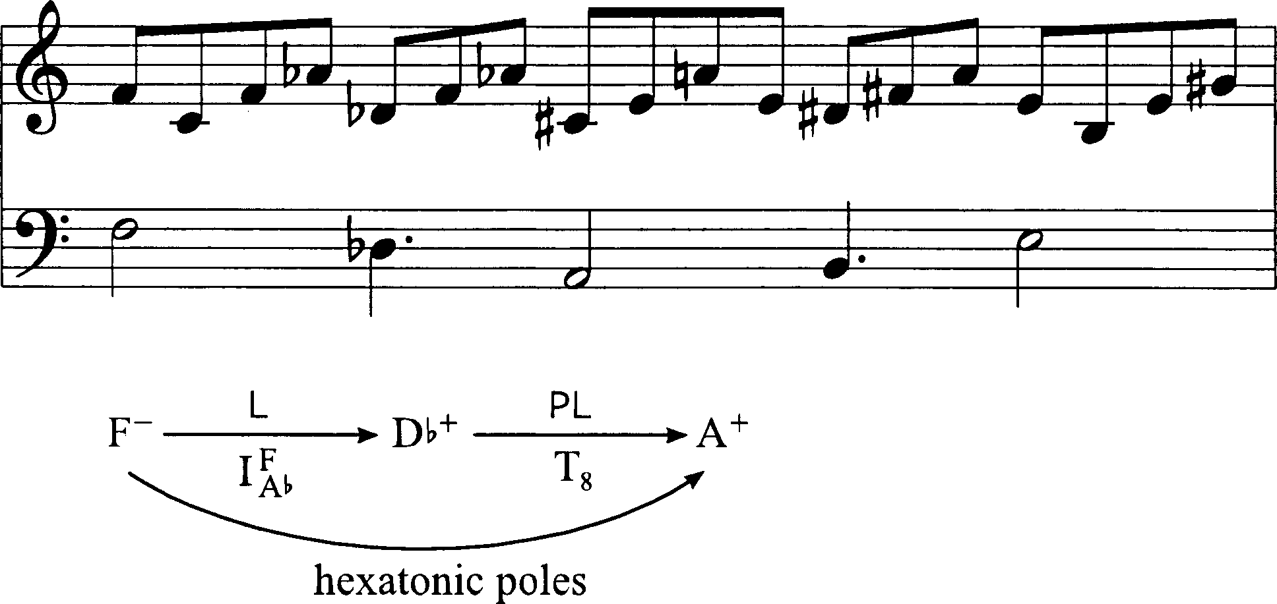

Slide 21
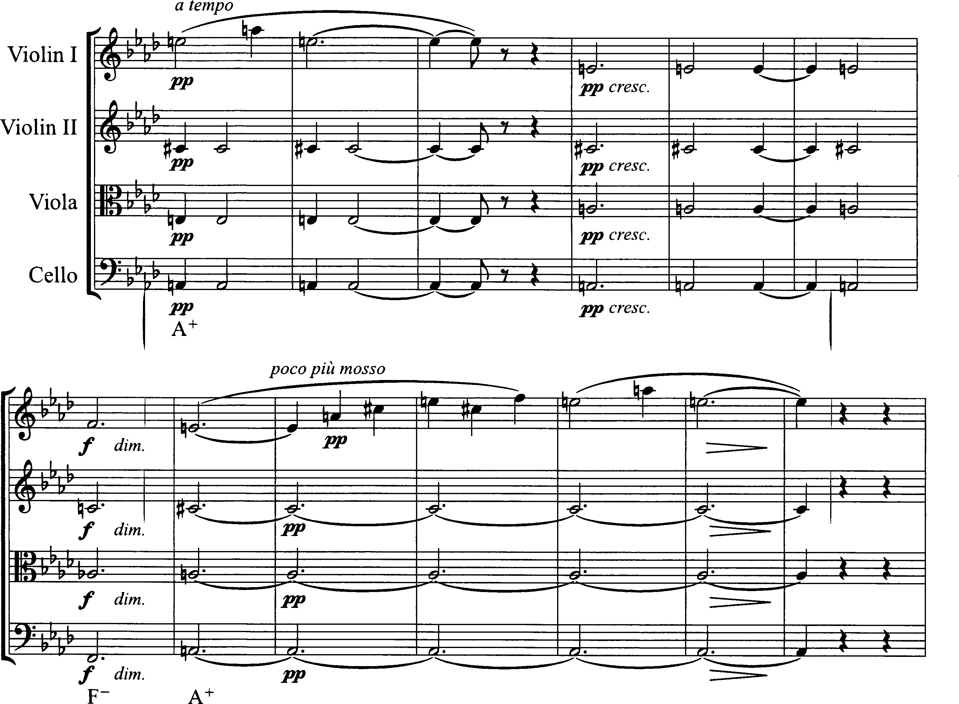

Slide 22
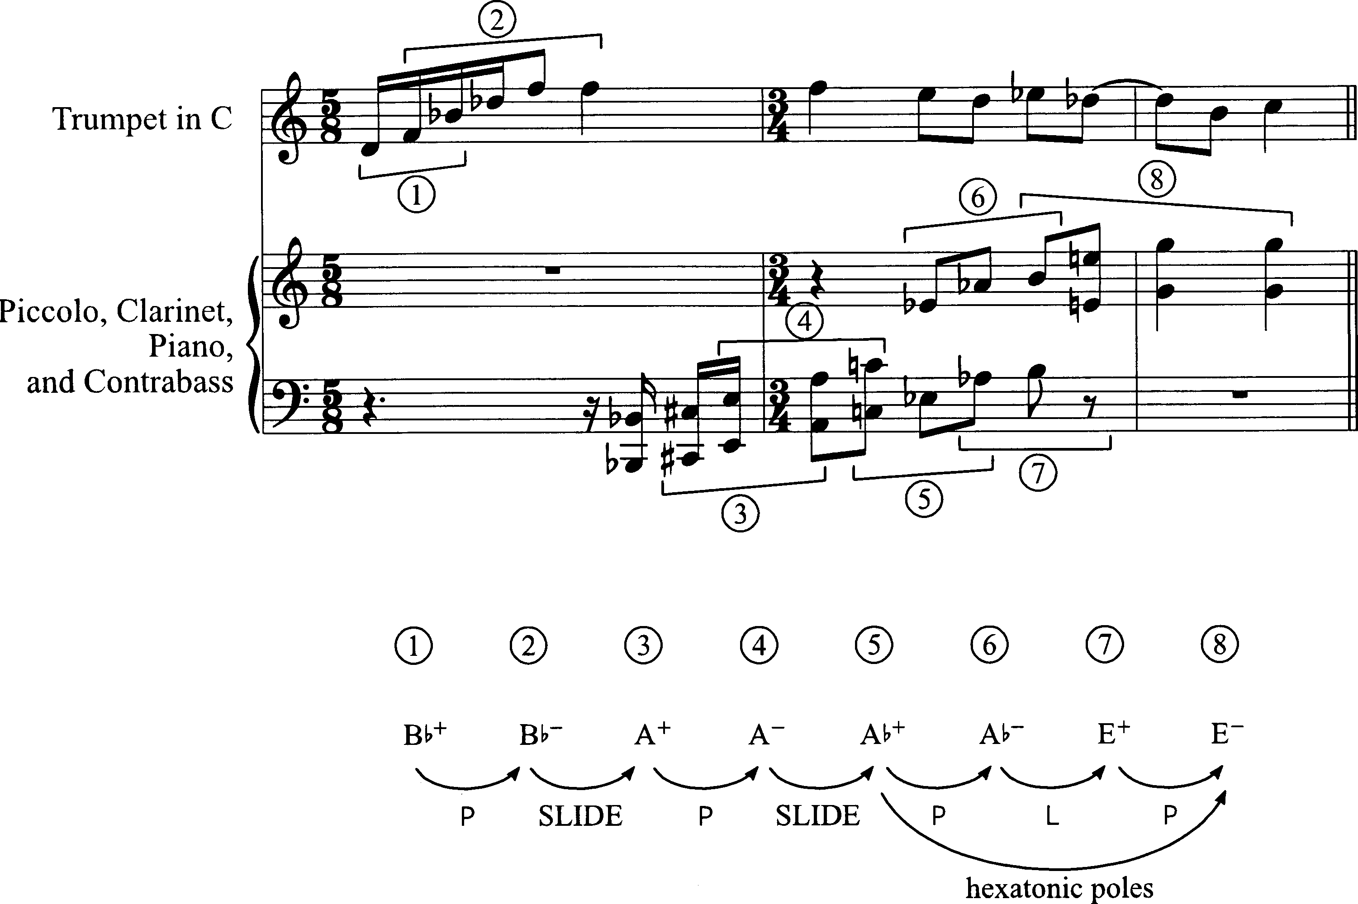

Slide 23
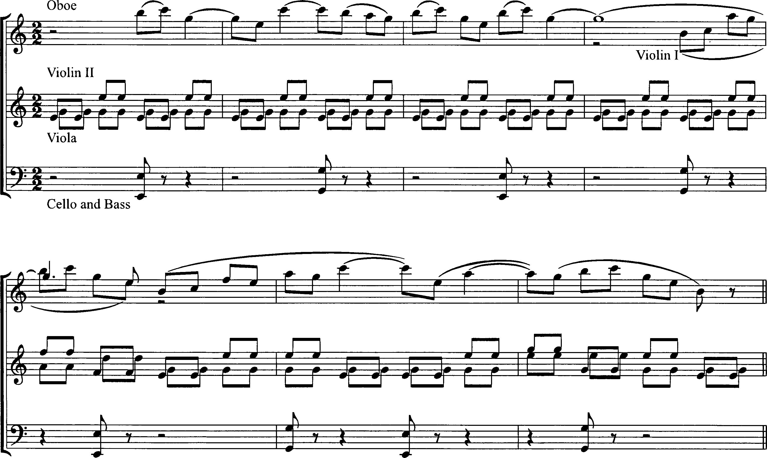

Slide 25
