Slide 1
More from Straus ch 4
transformational voice-leading

Slide 2
transformational voices
Our discussion of composing-out an interval cycle is mostly concerned with the ways in which one note can be heard to move to another and the resulting melodic lines.
A more abstract aspect of organization is the movement of transformational voices
A line is literal and concrete a voice results from underlying harmonic transformation
One good way to describe voice leading in post-total music involves paying attention to the pitch-class counterpoint created by transposition and inversion
Transposition and inversion involve mapping notes from one set to those in the next

Slide 3
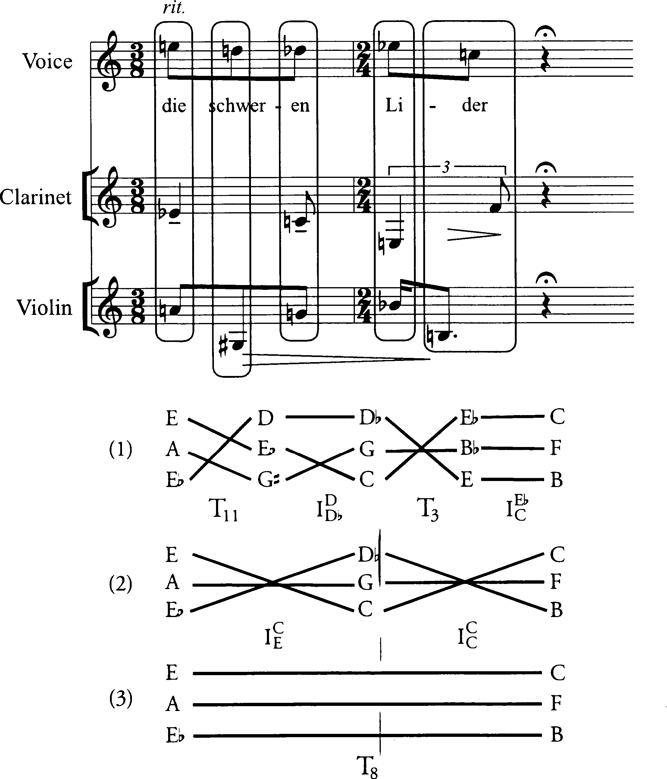

Slide 4
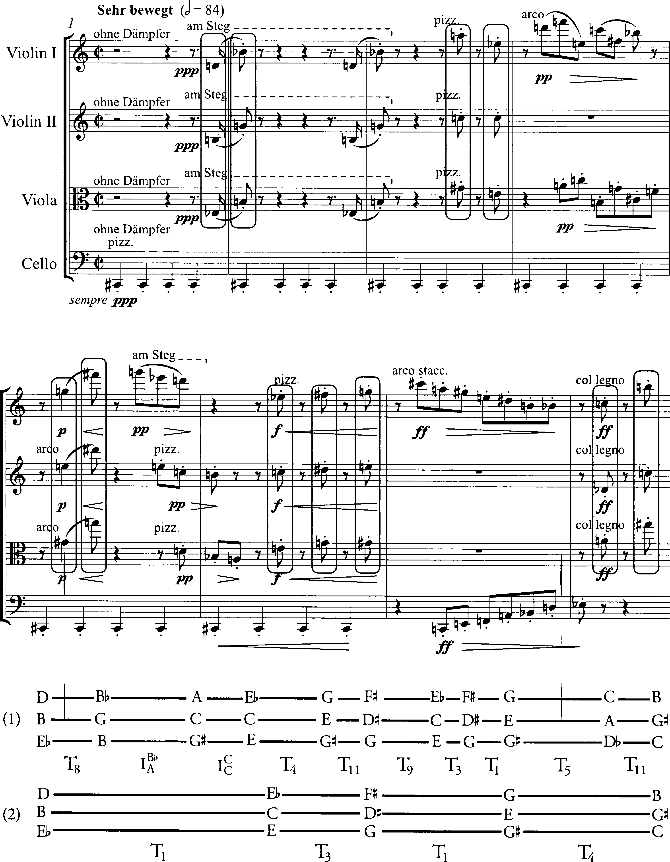

Slide 5
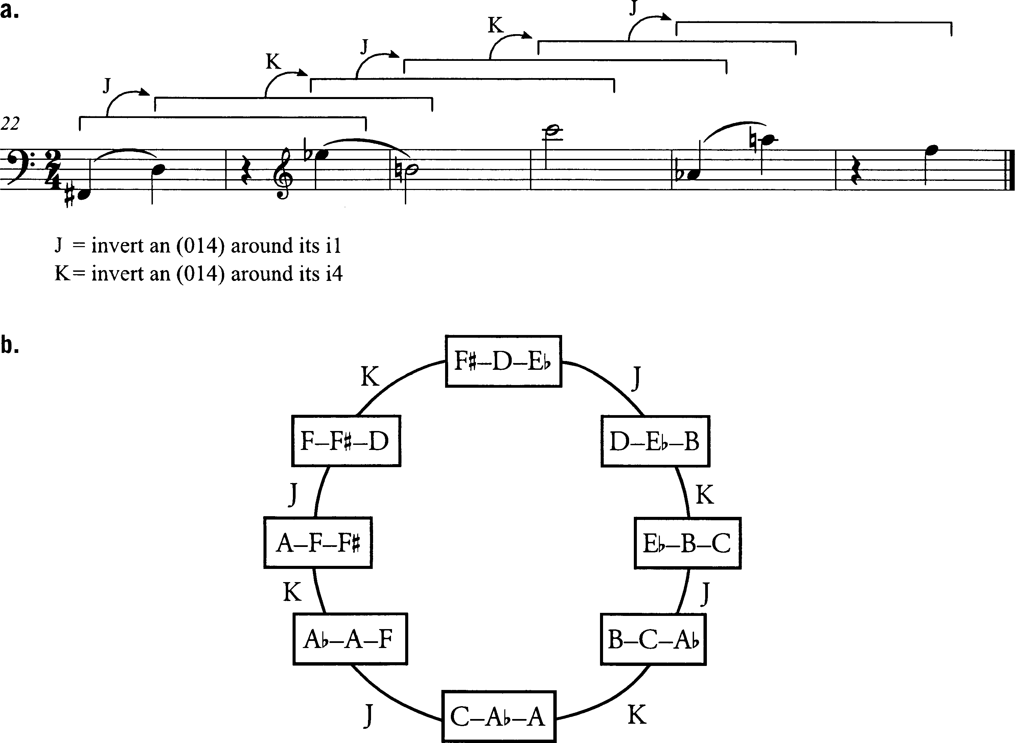

Slide 6
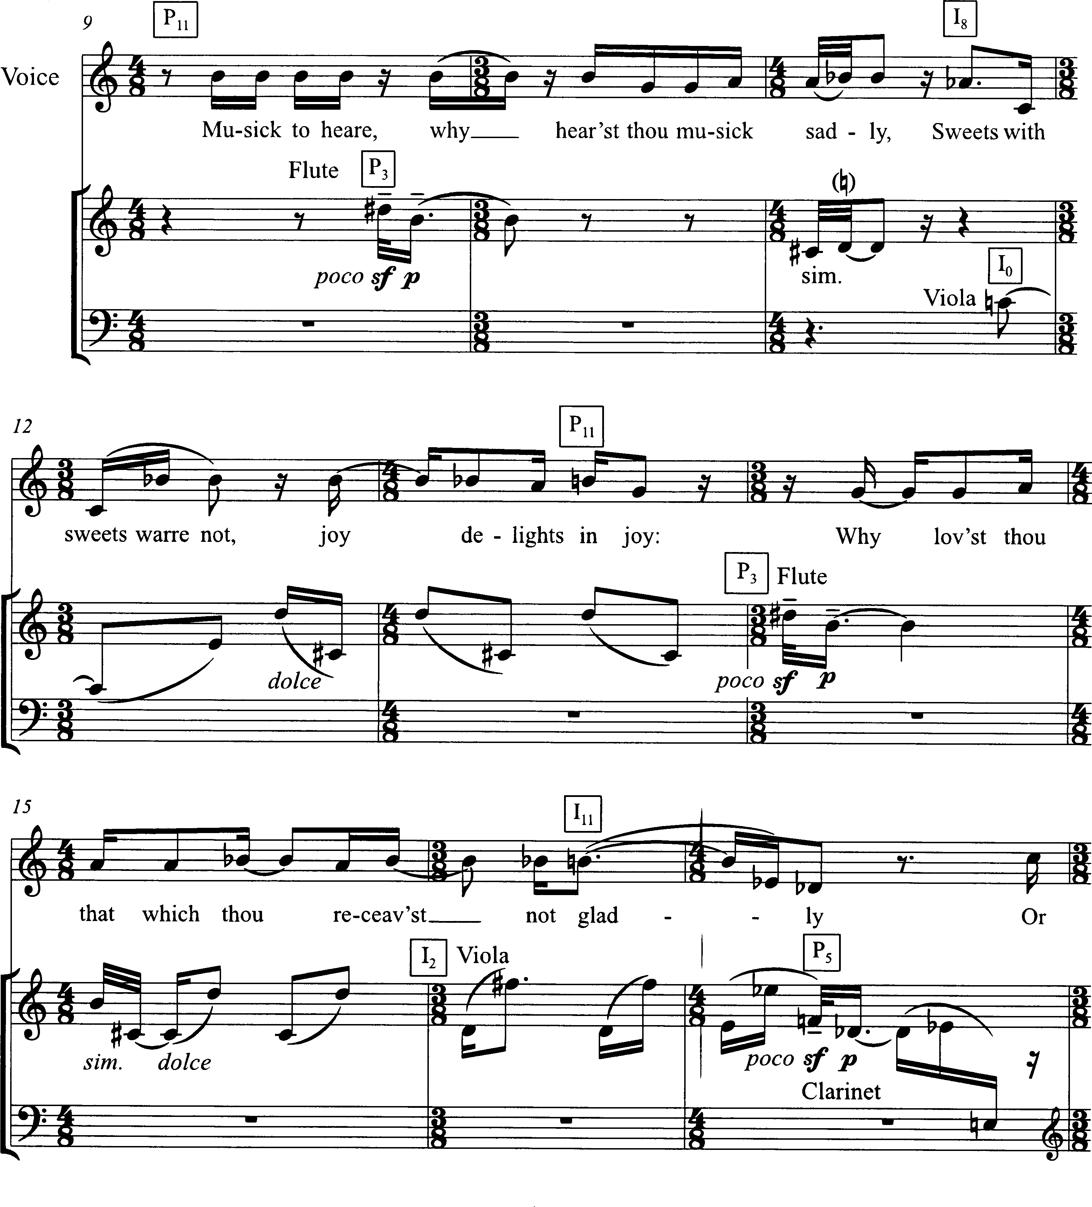

Slide 7
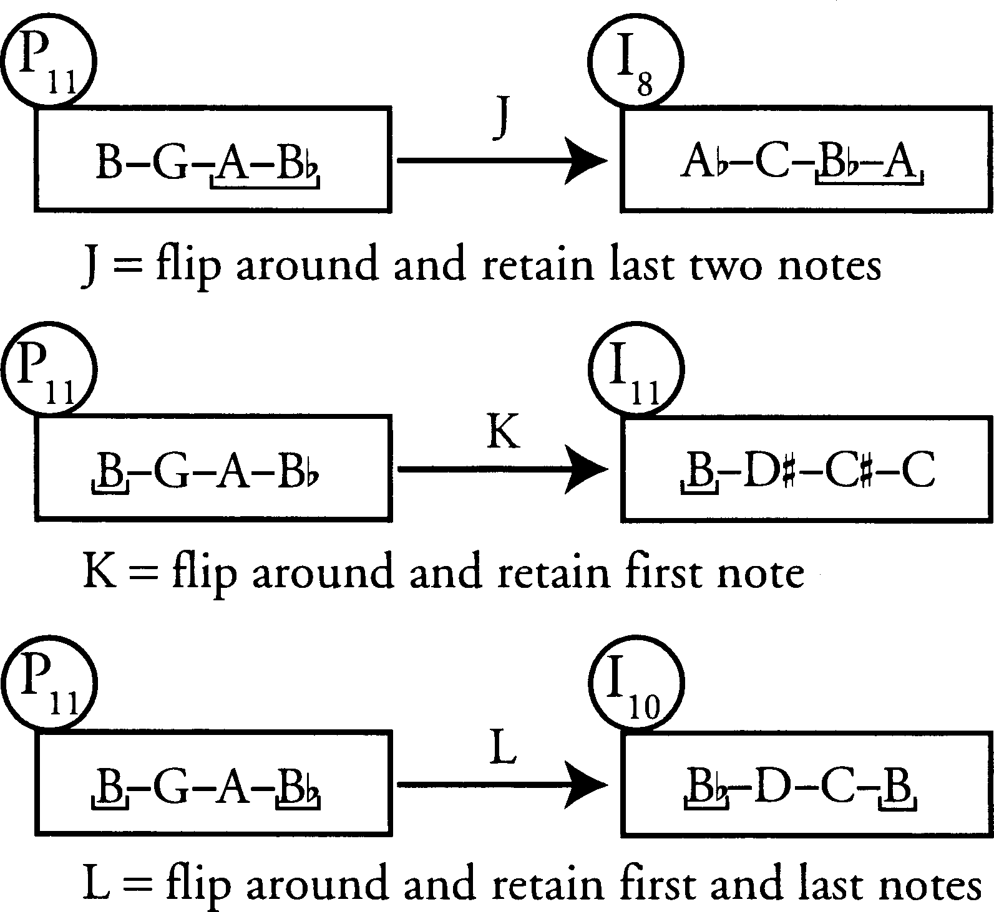

Slide 8
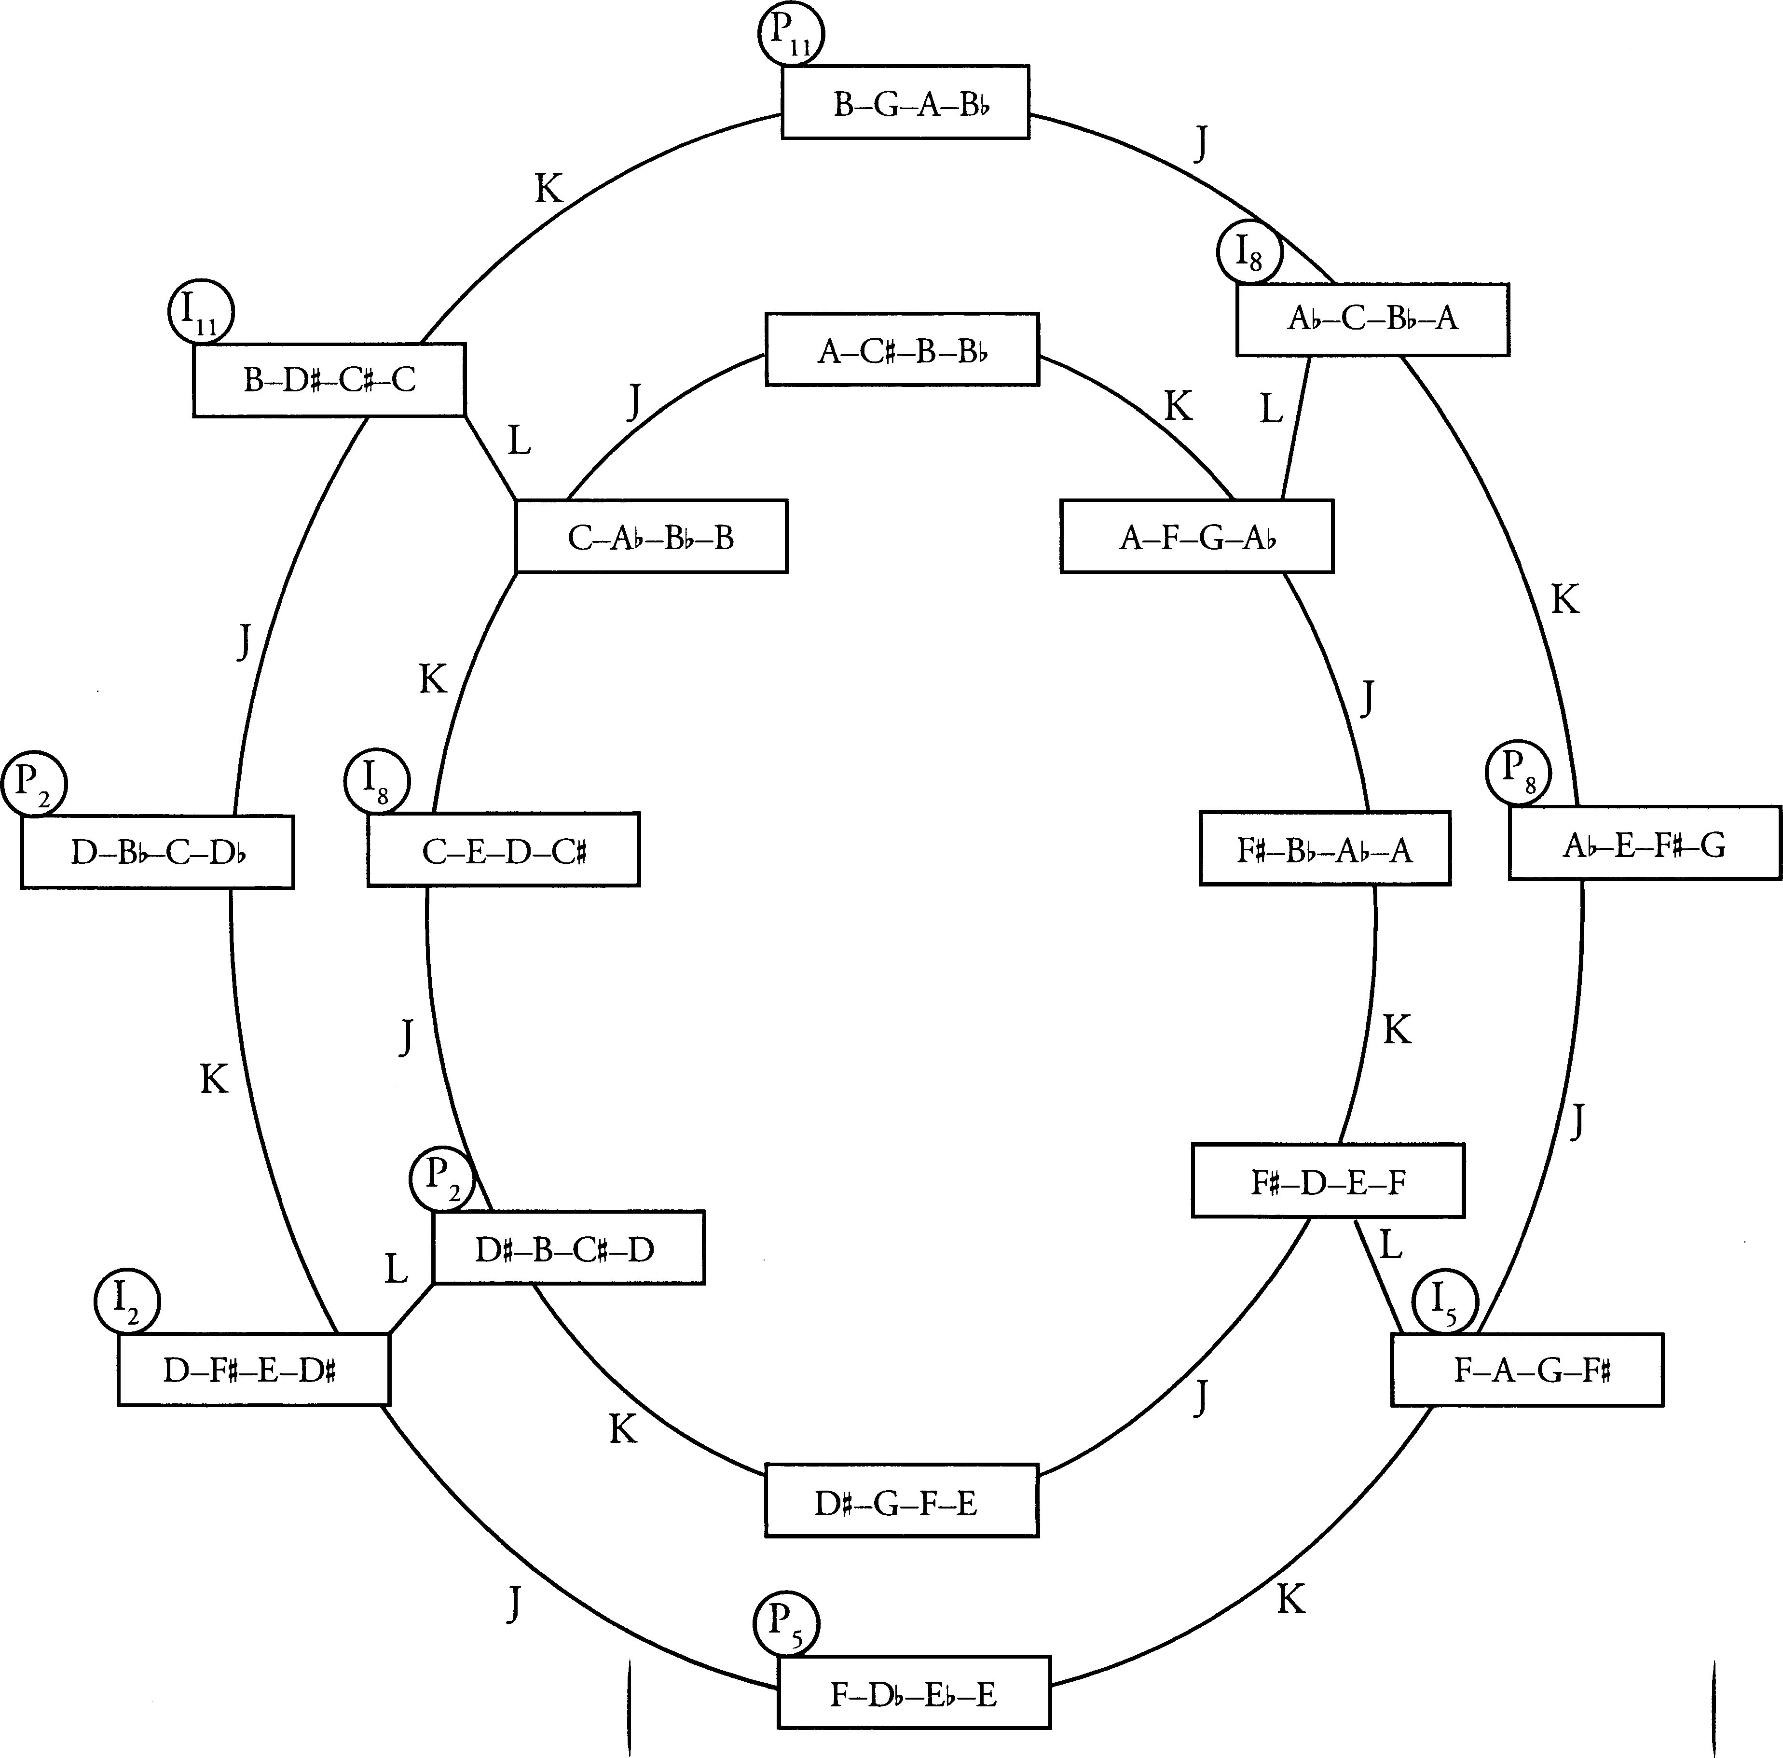

Slide 9
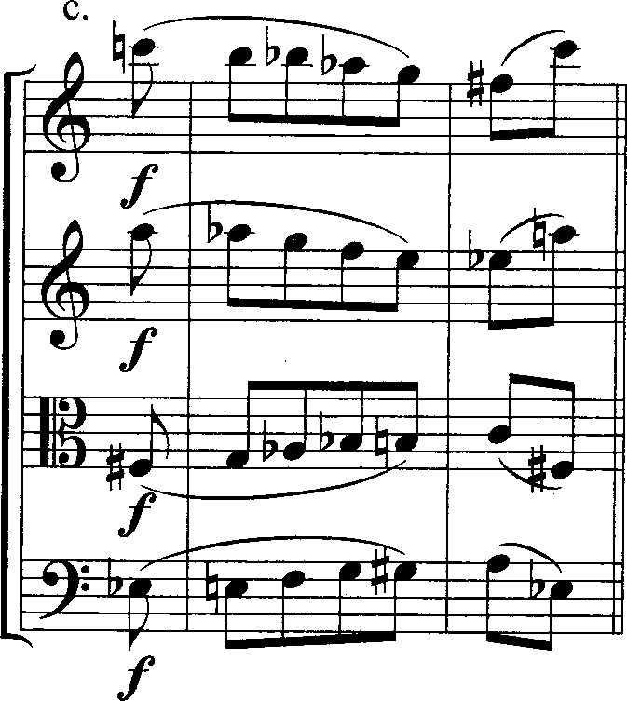
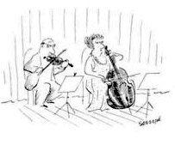
C---B---Bb-Ab-G---F#--C A---Ab-G---F---E---Eb--A F#-G---Ab-Bb-B---C----F# Eb-E---F---G---G#-A---Eb
regular inversion:
[0369] at I0
[0369] at I^{C} F#

Slide 10
contextual inversion:
Recursive retrograde inversion relations in the theme of
György Ligeti’s Metamorphoses Nocturnes

