Slide 1
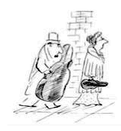
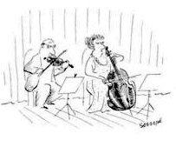
Introduction to Post-tonal theory
Pitch Centricity and Symmetry

Slide 2
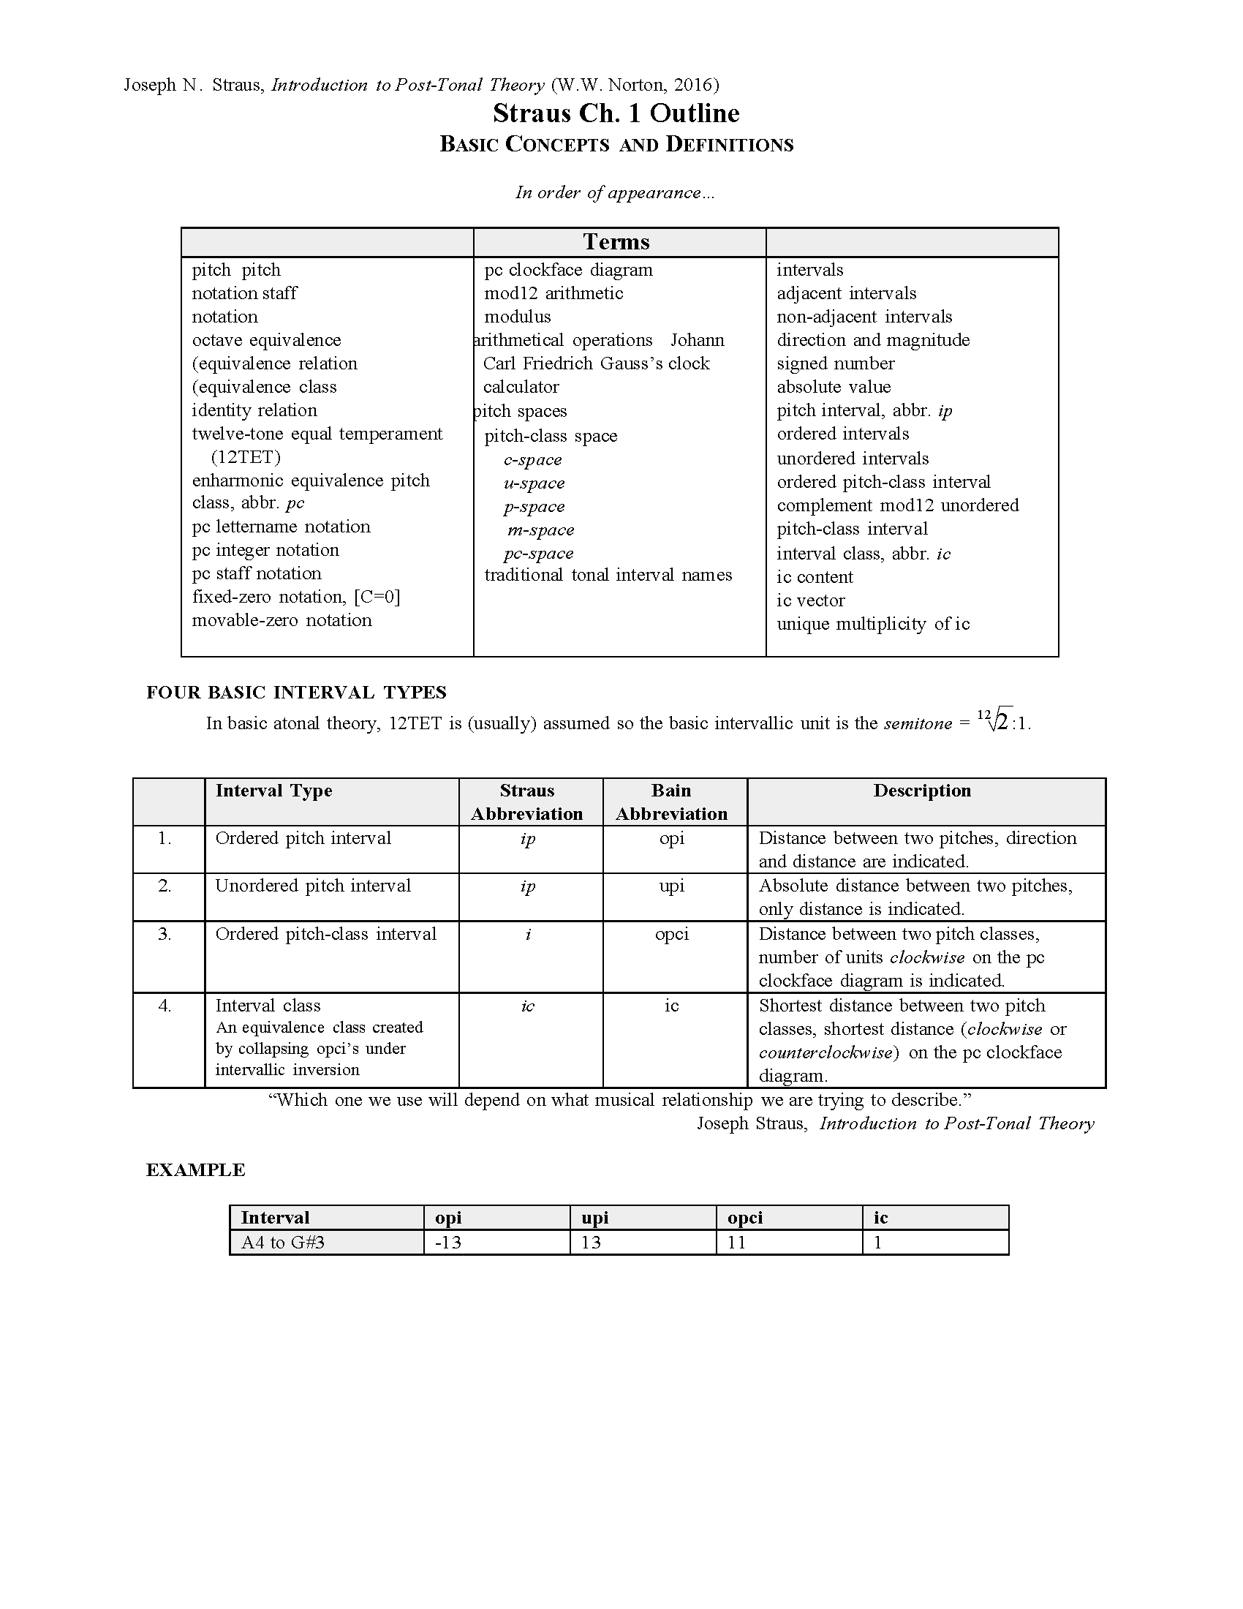

Slide 3
Interval Notation
Rock around the Clock
Pitch Interval: ordered vs. unordered
pitch-class interval i
ordered +, -, unordered
Interval class

Slide 4
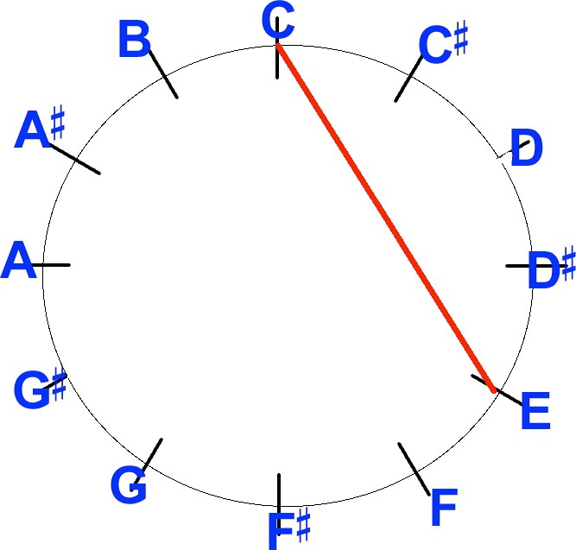
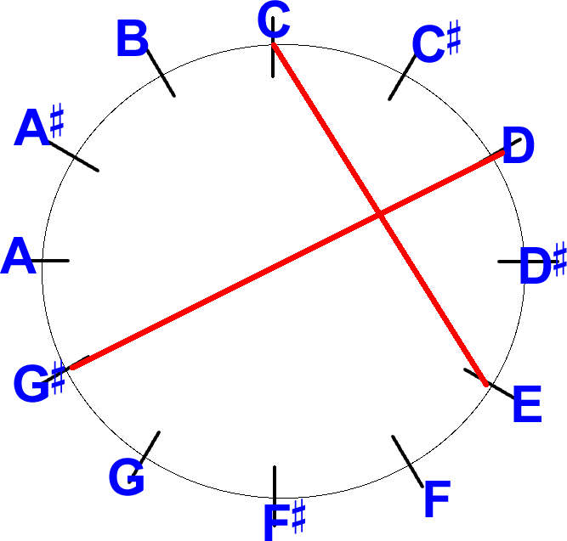
Pitch-class clock face

Slide 5
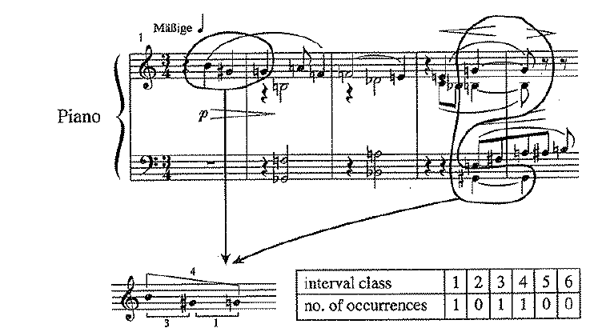
Interval-class content

Slide 6
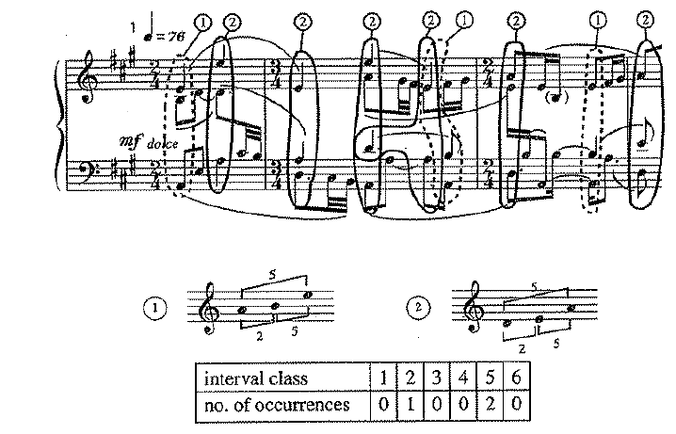
Interval-class content

Slide 7
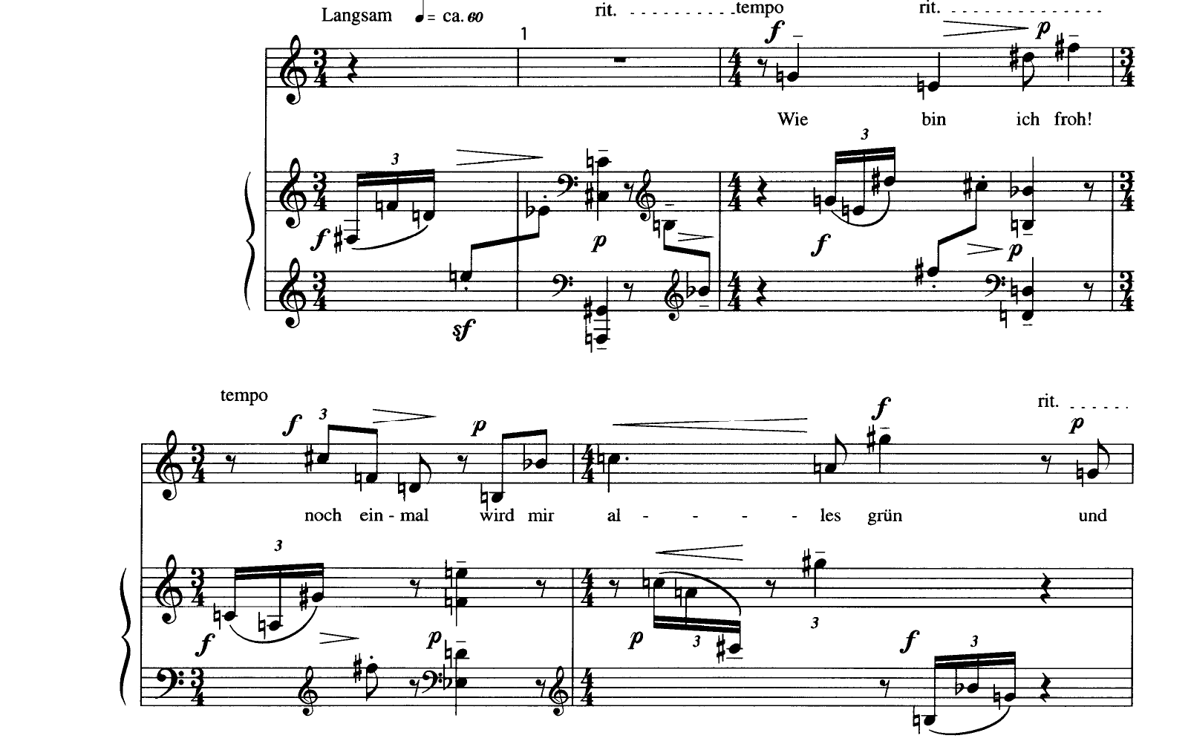
Wie bin ich froh!

Slide 8
-3 +11
G E D#
+8
pcs 7 4 3

Slide 9
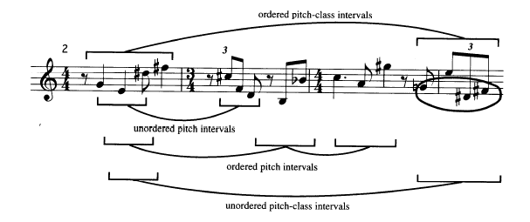
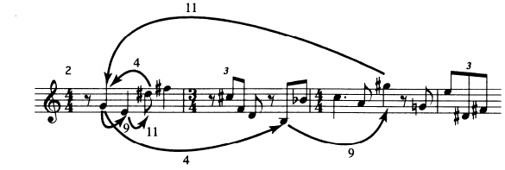
-4 +9
G B G#
+11
pcs 7 E 8

Slide 10
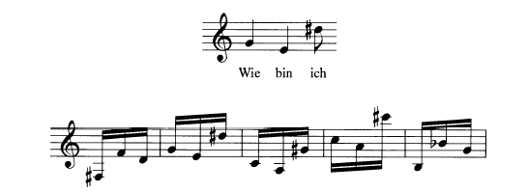

Slide 11
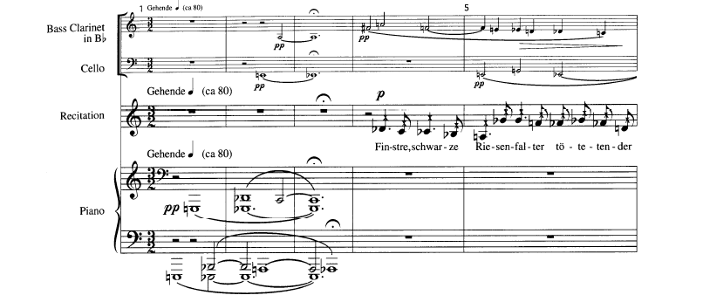
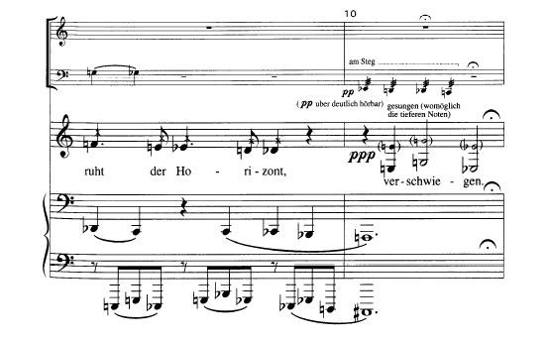
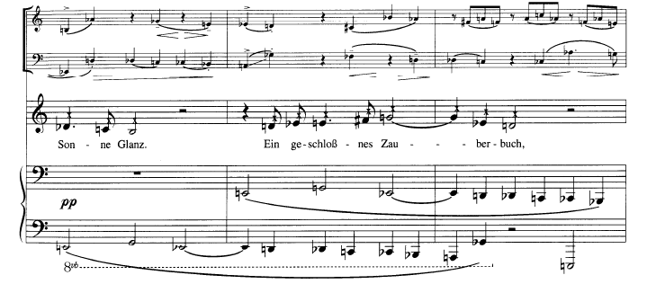

Slide 12
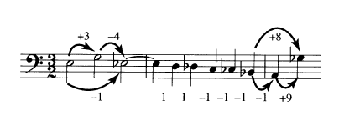
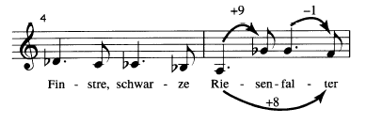

Slide 13
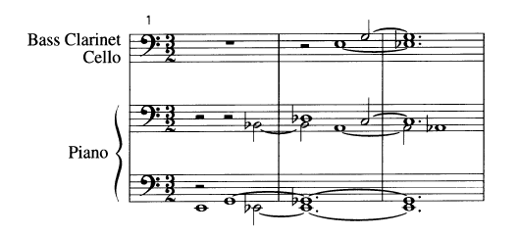
motivic saturation

Slide 14
Kaija Saariaho, Noa noa
This piece is composed for solo flute and interactive electronics. In the opening passage,the electronics consist mostly of extended reverberation.
This passage uses only nine pitches representing nine different pitch classes. Arrange them in registral order, from lowest to highest (D4—F4—Gb4 . . .). Do any intervals recur?
Any combinations of intervals?

Slide 15
Kaija Saariaho, Noa noa
Now arrange the notes in the order in which they are introduced (C—E—Gb. . .). Do any intervals recur? Any combinations of intervals?Any combinations of intervals?
Finally, look at the actual intervals formed by adjacent notes in the melody. Do any intervals recur? Any combinations of intervals?
Can you relate these to the intervals formed by the registral order? The order in which the notes are introduced?

Slide 16
