Slide 1
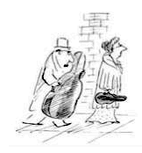
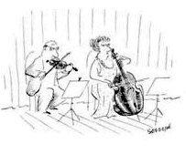
Interval Cycles
Pitch Centricity and Symmetry

Slide 2
Interval Cycles and Equal Divisions of the Octave
Interval 1 = i1, interval 2 = i2, etc.
Equal divisions of the octave

Slide 3
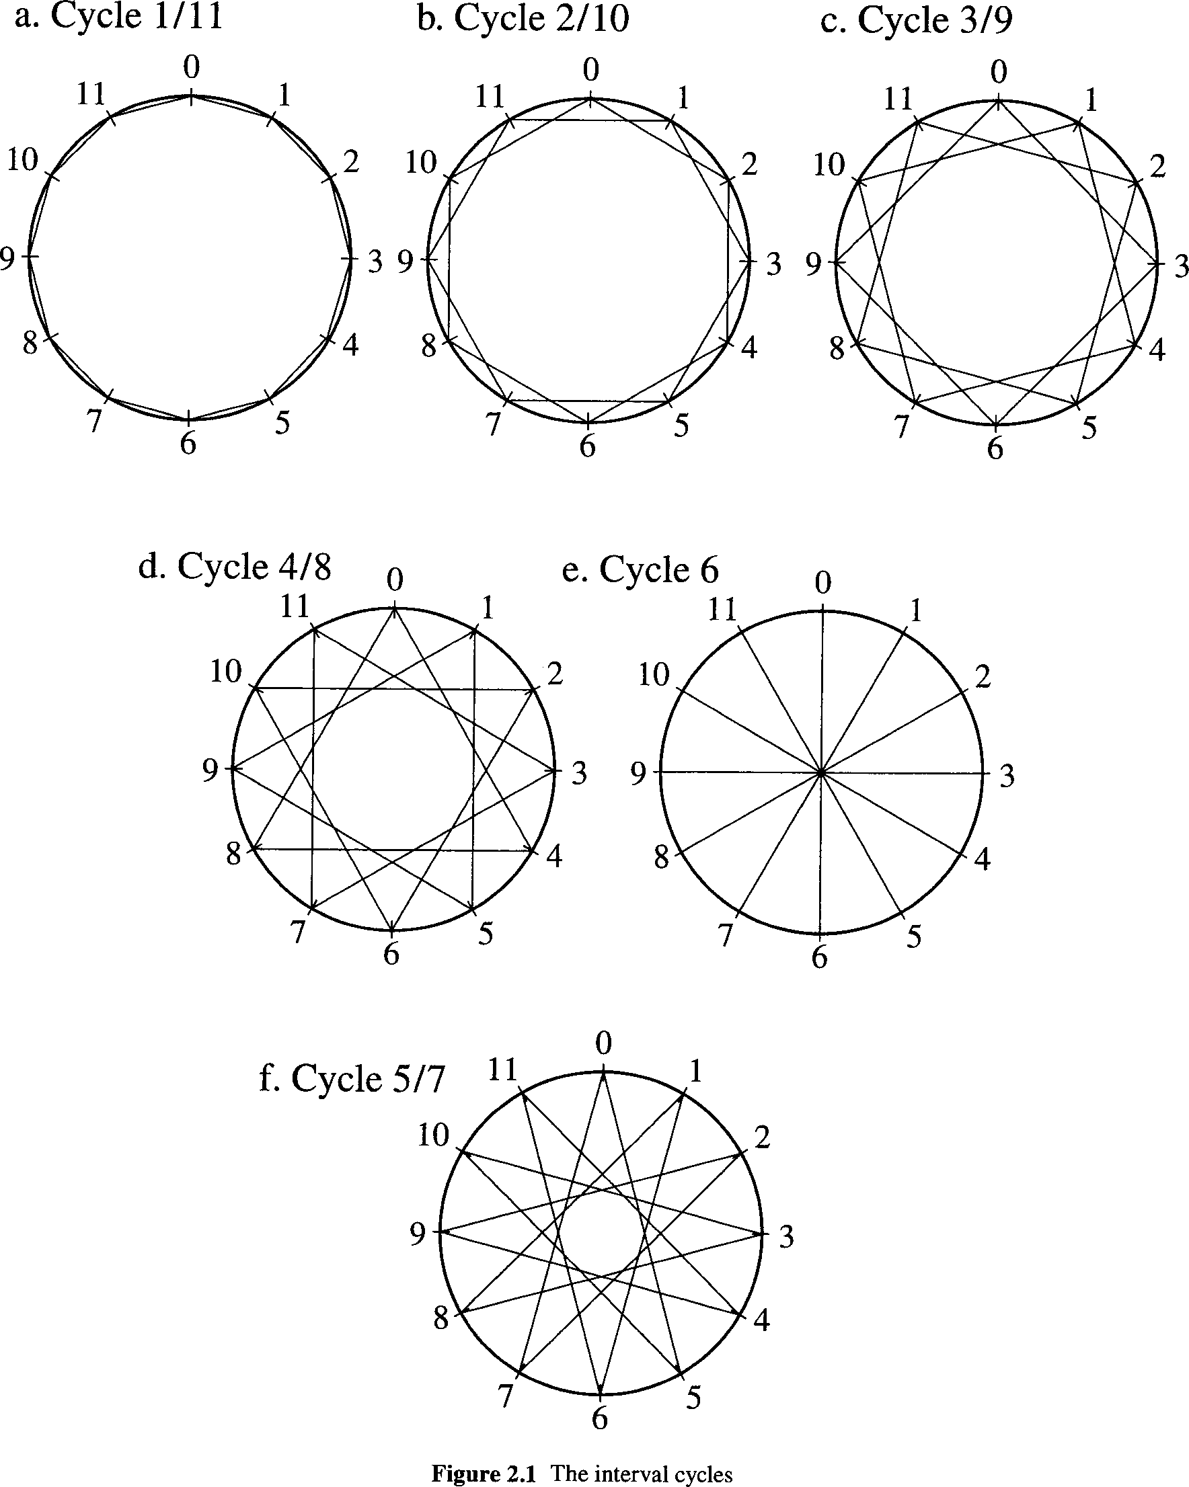

Slide 4
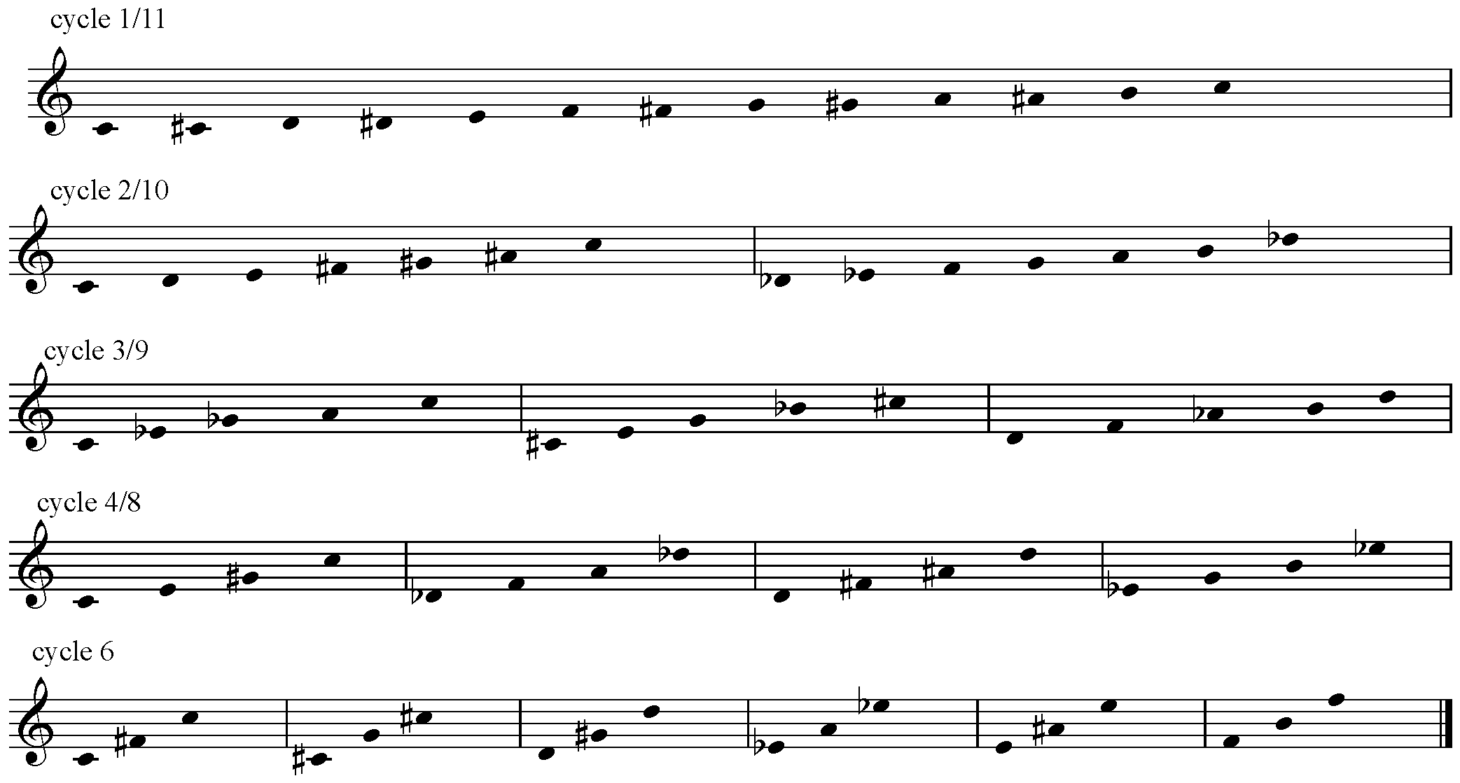
C5 = circle of fifths
C1
C20
C21
C30
C31
C32
C40
C41
C42
C43
C60
C62
C63
C64
C65
C61

Slide 5
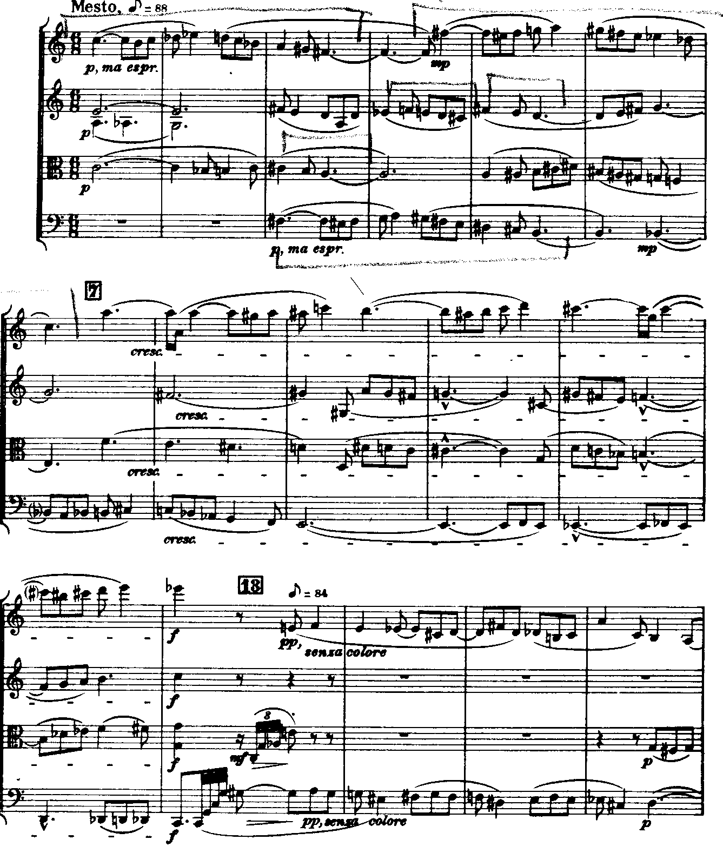
C30
Bartók,
String Quartet #6, iv
C21
[0369]

Slide 6
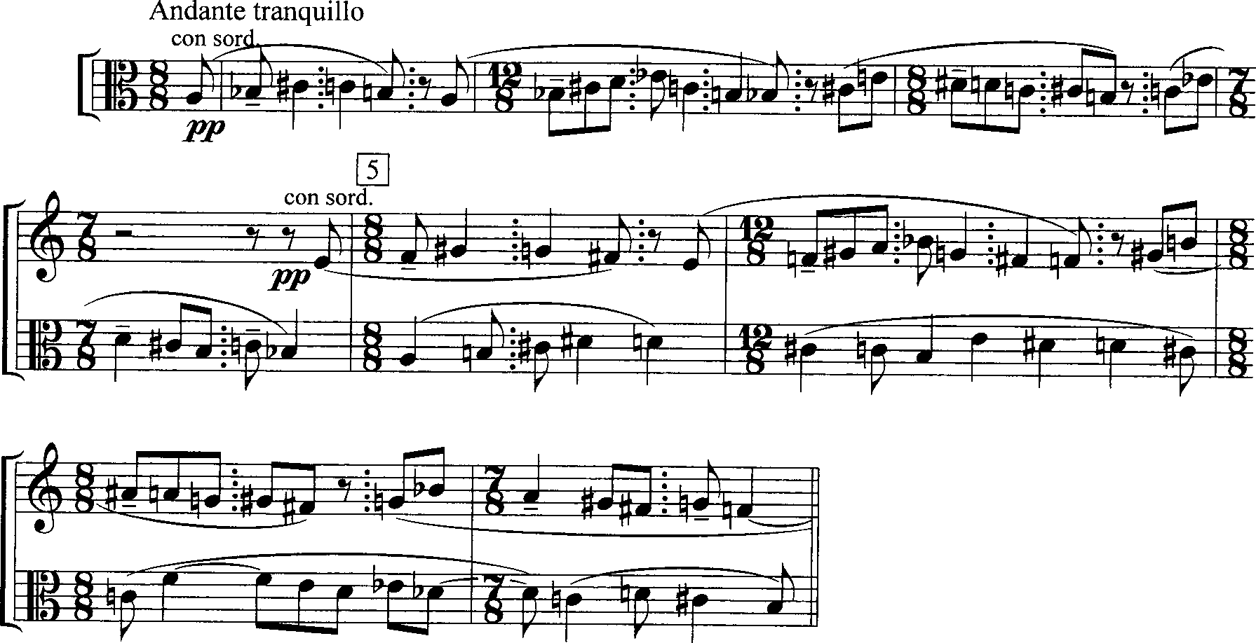
Theme, Music for Strings, Percussion & Celesta
M3
D5-P4
P4
A3
E4

Slide 7
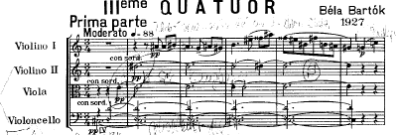
Bartók,
String Quartet #3, i
F-F#-G-G#-A-A#-B-B#
C#-D-D#-E

Slide 8
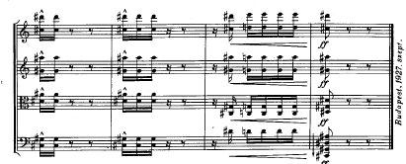
Bartók,
String Quartet #3, iv
C#-G#-D#-A#

Slide 9
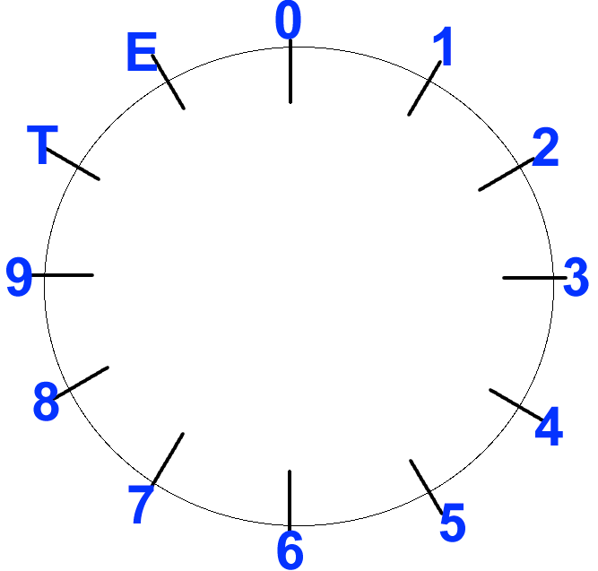
Maximal evenness with even collections

Slide 10
Maximal evenness with even collections

Slide 11
Maximal evenness with odd collections
Pentatonic collection
“Mystic” chord

Slide 12
Maximal evenness with odd collections
Diatonic collection

Slide 13
Combination cycles
<1,8>

